Slide 1
DoD Software Modernization
Unclassified
March 2021
Jason Weiss
Rob Vietmeyer
Unclassified

Slide 2

Ability to Fight and Win is Software Dependent
UNCLASSIFIED
New software = new capabilities: Capabilities of weapons systems and other critical systems are defined by their software
Rapidly respond to emerging threats: Response to emerging threats is increasingly determined by the time required to develop and deploy software to the field
Enable innovation: Modern software practices are critical to effective use of new technologies: cloud computing, artificial intelligence, machine learning, robotics, internet of things
Challenge: The current approach to software development is a leading source of risk to DoD: it takes too long, is too expensive, and exposes warfighters to unacceptable risk
Need to accelerate: Improvements in how we acquire software are happening, but adoption has been limited
Software is a foundational component of the modern military
UNCLASSIFIED

Slide 3
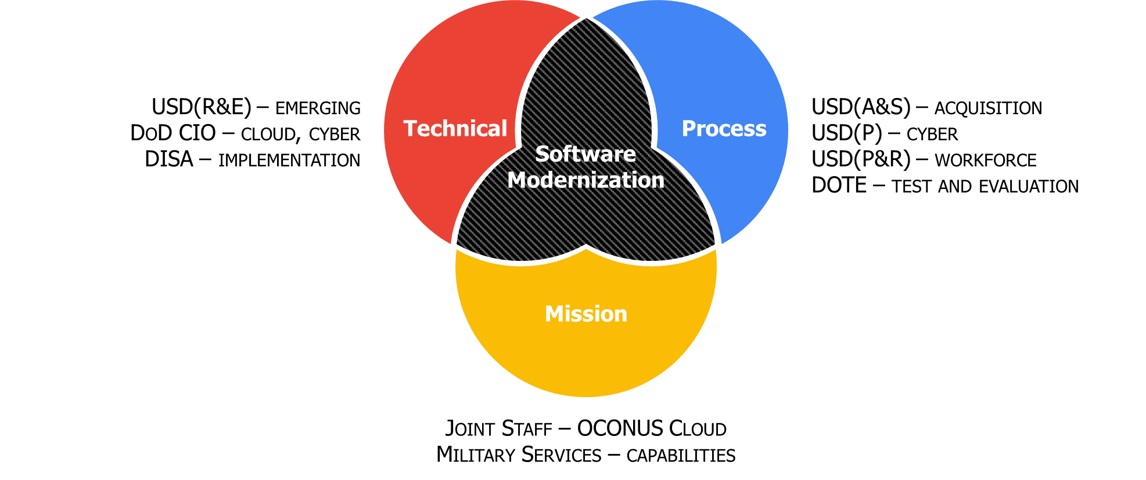
Software Modernization Coalition

Slide 4
Software Modernization Focus
Shifting secure software delivery left by betting big on infrastructure and platforms
Cementing speed and security with true process transformation

Slide 5


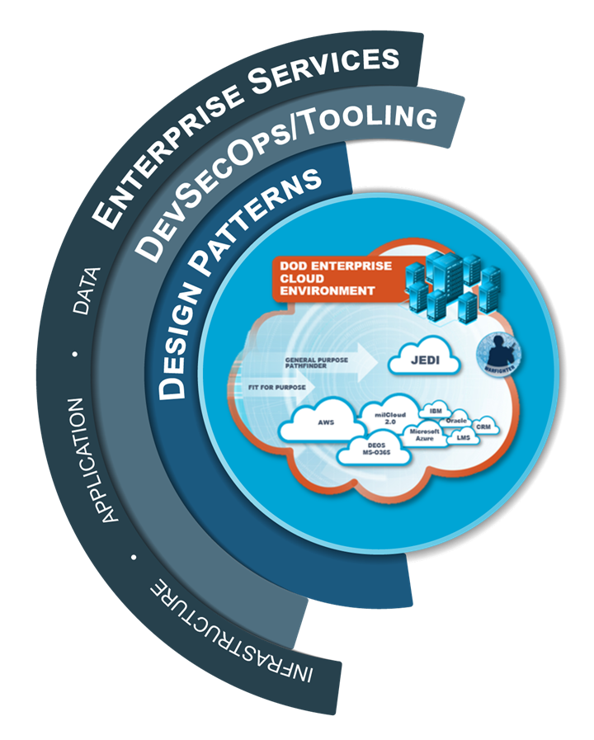









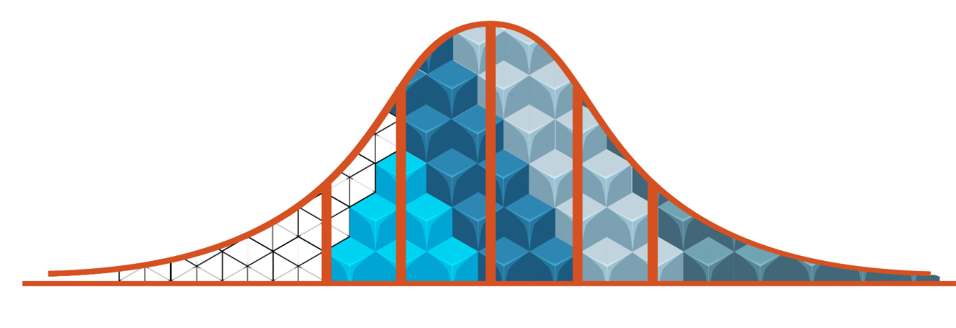








UNCLASSIFIED
DOD SOFTWARE MODERNIZATION
Deliver Resilient Software Capability at the Speed of Relevance
TECHNICAL COMPONENTS
PROCESS COMPONENTS
OUTCOMES
Plug and Play for Rapid Assembly
Acquisition
Must adapt to the unique needs and capabilities of modern software development
Business Operations
Must enable internal “services economy” for reusable software within DoD
Cyber Risk Management
Must automate cyber testing and authorization to keep pace with software delivery
Test and Evaluation
Must bridge operational testing with software development
CHALENGES
Workforce
Must evolve the workforce to address changes in process and technology
Continuous Secure Delivery
DEVELOPMENT
SPECTRUM
Global Delivery of Elastic Compute
Automated Deployment
Development Spectrum of DoD Software Projects
IMMATURE
Legacy
MATURE
Cloud-Ready
Development Maturity
Determines Entry Point
CLOUD
DESIGN
PATTERNS
DEVSECOPS /
TOOLING
ENTERPRISE
SERVICES
UNCLASSIFIED

Slide 6

Design Patterns Value Proposition
Automated.
Fast platform build-outs through templates
and blueprints based on commercial patterns.
Accelerated Delivery
Consistent.
Pre-configured, pre-authorized virtual infrastructure
as Platform as a Service (PaaS)
Mission Owners
Secure.
Leverages CSP managed security services over
traditional data center tooling

Slide 7
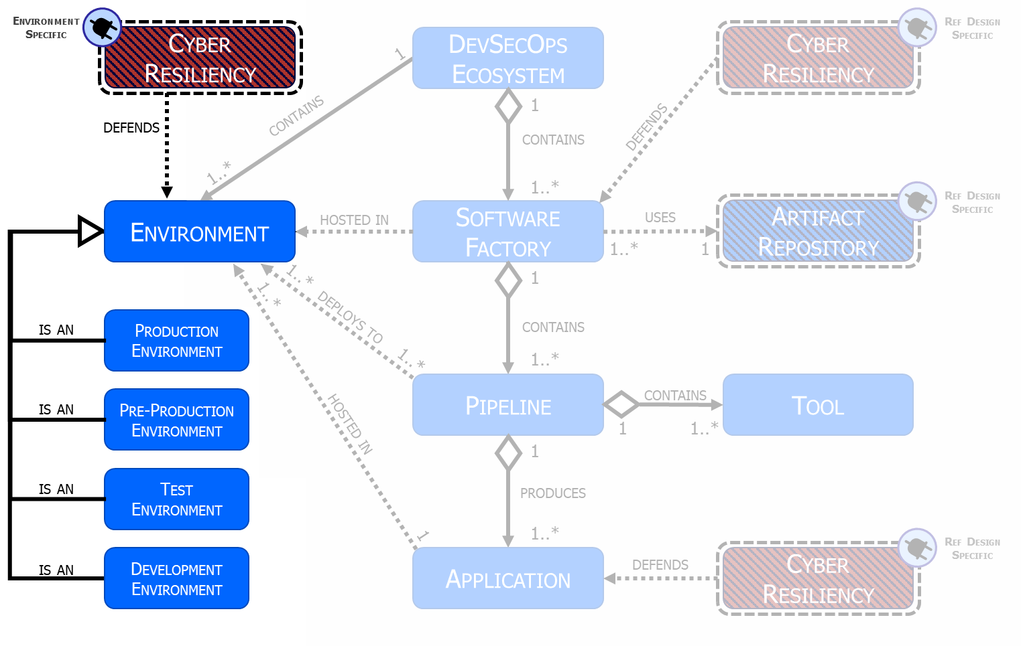
Push Button; Get Secure Cloud Environment
IaC helps customers
adopt cloud faster

Slide 8
IAC-Blueprint Permissions Policies
Least Privilege
Two-Person Rule
Permissions are granted at the lowest level practical
Elevated privileges require a second person’s approval
Separation of Duties
Distinguished Permissions
Groups are defined so responsibilities are divided among them
Strict permissions in production; less stringent permission in development

Slide 9
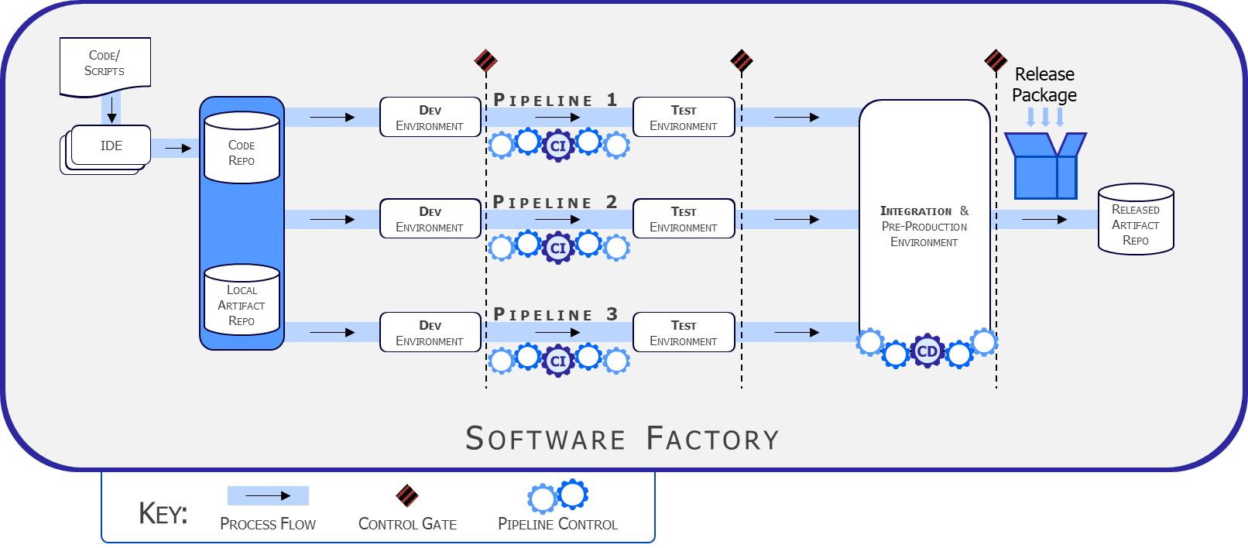
Inherit RMF Controls at Each Step
Value:
Controls:
Continuous ATO
IaC
Physical Site
IaaS
Platform
Application
Software Factory

Slide 10
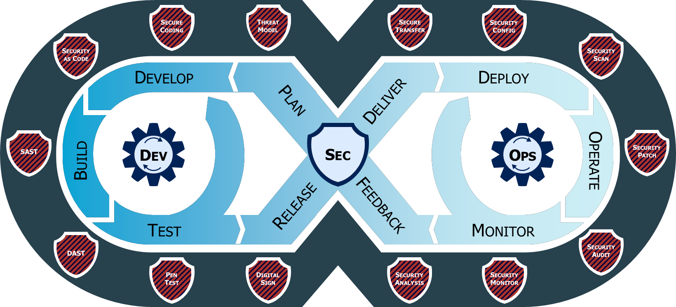
Role of the DevSecOps Software Factory

Slide 11
Unclassified
Unclassified

