Slide 1
DevSecOps and Continuous Authorization
March 2021
Jason Weiss
Rob Vietmeyer

Slide 2
What is DevSecOps?
DevOps
A change in IT culture, focusing on rapid IT service delivery through the adoption of agile, lean practices in the context of a system-oriented approach. DevOps emphasizes people (and culture), and it seeks to improve collaboration between operations and development teams. DevOps implementations utilize technology — especially automation tools that can leverage an increasingly programmable and dynamic infrastructure from a life cycle perspective. (Gartner IT Glossary)
DevSecOps
The integration of security into emerging agile IT and DevOps development as seamlessly and as transparently as possible. Ideally, this is done without reducing the agility or speed of developers or requiring them to leave their development toolchain environment. (Gartner IT Glossary)

Slide 3
Industry’s DevSecOps Lessons Learned
Delivering software quickly, reliably, and safely is at the heart of technology transformation and organizational performance
  We see continued evidence that software speed, stability, and availability contribute to organizational performance (including profitability, productivity, and customer satisfaction). Our highest performers are twice as likely to meet or exceed their organizational performance goals.
The best strategies for scaling DevOps in organizations focus on structural solutions that build community
High performers favor strategies that create community structures at both low and high levels in the organization, including Communities of Practice and supported Proofs of Concept, likely making them more sustainable and resilient to reorgs and product changes
Cloud continues to be a differentiator for elite performers and drives high performance
The highest performing teams were 24 times more likely than low performers to execute on all the capabilities of cloud computing
There’s a right way to handle the change approval process, and it leads to improvements in speed and stability and reductions in burnout
Heavyweight change approval processes, such as change approval boards, negatively impact speed and stability. In contrast, having a clearly understood process for changes drives speed and stability, as well as reductions in burnout
https://services.google.com/fh/files/misc/state-of-devops-2019.pdf

Slide 4
Industry’s DevSecOps Performance: How do you compare?
Aspect of Software Delivery Performance | Elite | High | Medium | Low
Deployment frequency How often does your organization deploy code to production or release it to end users? | On-Demand (multiple deploys per day) | Once per day to once per week | Once per week to once per month | Once per month to once every six months
Lead time for changes How long does it take to go from code committed to code successfully running in production? | Less than one day | Between one day and one week | Between one week and one month | Between one month and six months
Time to restore service How long does it generally take to restore service when a service incident or a defect occurs? | Less than one hour | Less than one day | Less than one day | Between one week and one month
Change failure rate What percentage of changes to production result in degraded service and subsequently require remediation? | 0-15% | 0-15% | 0-15% | 46-60%
https://services.google.com/fh/files/misc/state-of-devops-2019.pdf

Slide 5
DevSecOps Requires Breaking down barriers
Development
Cyber Assessment
Operations
ATO/IATT
Host Env
Scrum
Agile
Compliance
Performance
CI/CD
Sprint
RMF
Network
800-53
CSSP
Go Faster
Prove that it’s secure
How will I maintain and defend it

Slide 6
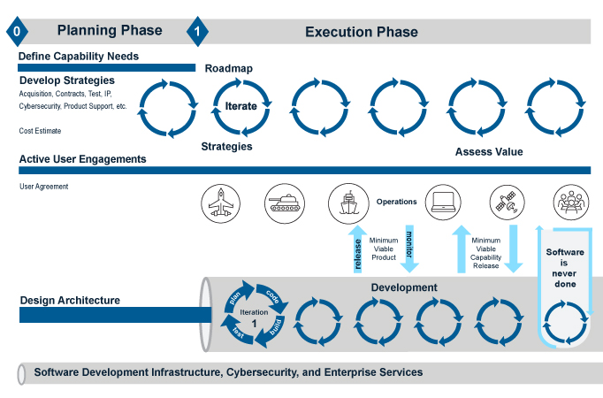
Helping to Reduce Barriers to DevSecOps
DODI 5000.87 Software Acquisition Pathway
DoD CIO and USD(A&S) Memo, Software Development, Security and Operations for Software Agility
  Established DevSecOps as the preferred acquisition approach
DODI 5000.87 Software Acquisition Pathway
Technical Guidance
  DevSecOps Reference Design
  Container Hardening Guide
  Container Creation and Deployment Guide
https://aaf.dau.edu/aaf/software/

Slide 7
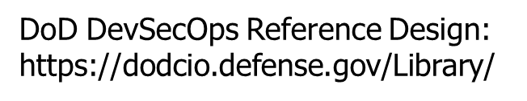
Key Components: Platform, Process, People
Acquisition Organization
Teams
Platform
Platform
Team
DevSecOps
App Team
Specific
Pipeline(s)
Production
Environment
Software Factory Processes
*Production Environment may be external to the platform

Slide 8
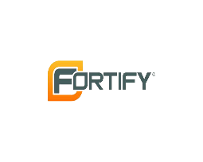
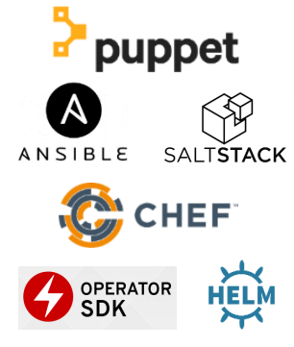
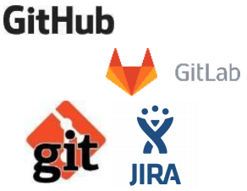

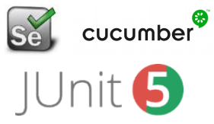
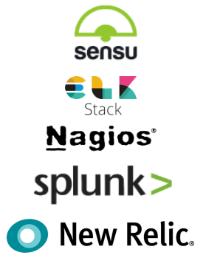
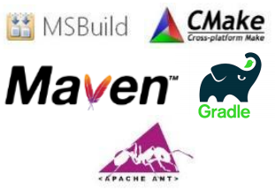
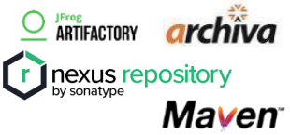
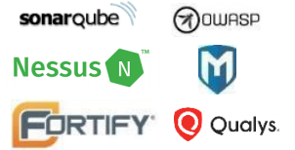
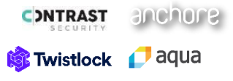
DevSecOps Platform: Toolchains
Automation is essential
Create integrated toolchains that span the entire life-cycle
Collaborate with security team to integrate security into the toolchain
-”Shift-Left” &
-Continuous Monitoring
Incomplete example of the many tool choices available
Plan
Develop
Build
Test
Release & Deliver
Deploy
Operate
Cybersecurity Automation (Scanning, Testing, & Validating)
Monitor

Slide 9
Platform: Software Toolchains, Pipelines, and Factories
Moving to a platform approach
product A
Product B
Product C
product A
Product B
Product C
Maturation
toolchain A
toolchain B
toolchain C
DevSecOps Platform Services
Best Practices:
Implement a platform approach
Leverage existing platform services
If building your own,
  Leverage hardened COTS products/containers maintained by Platform One and available in Repo1
  Leverage DoD CIO’s Cloud Infrastucture as Code (IaC)
  Leverage DoD CIO’s Compliance as Code (CaC)
Repo1 Hardened Containers
More Info: software.af.mil
p1.dso.mil
Repo1: repo1.dso.mil
Registry1: registry1.dso.mil
DoD CIO Cloud IaC:
More Info: www.cloud.mil/Contact-us/
DoD CIO CaC:
More Info: public.cyber.mil/devsecops
https://gitlab.dsolab.io/scv-content

Slide 10
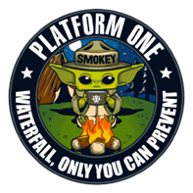
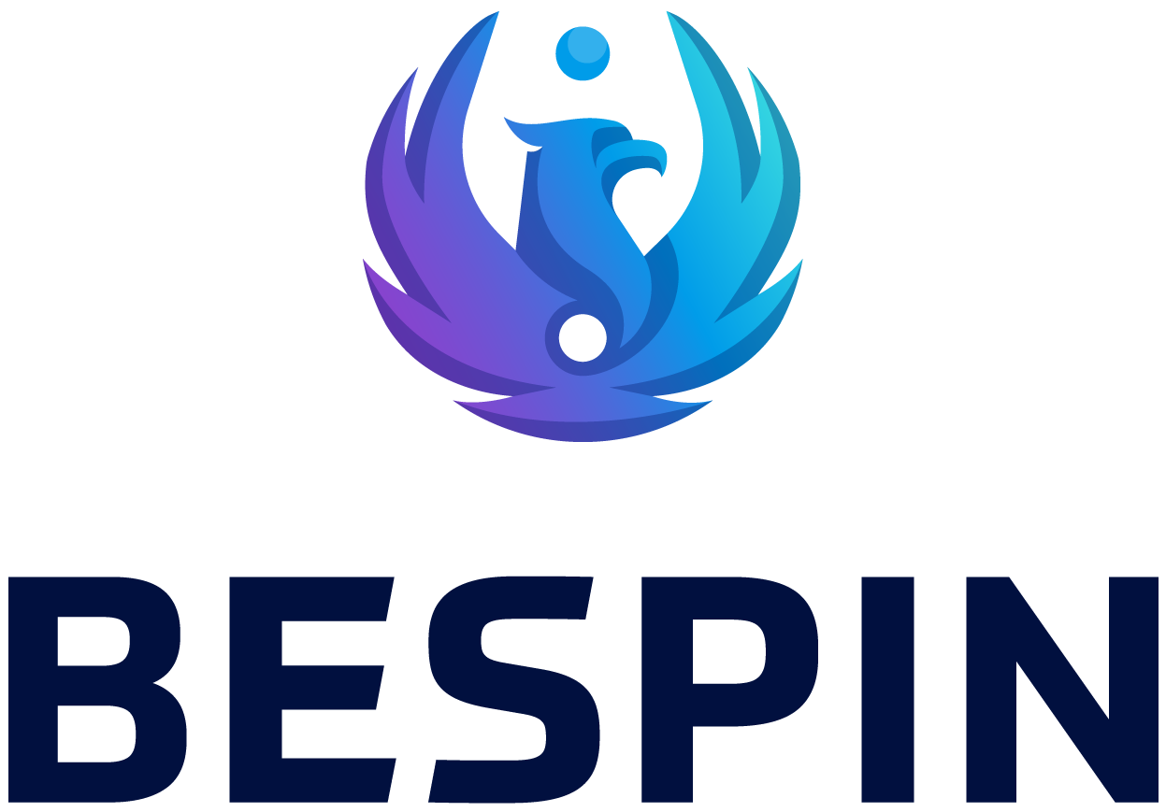




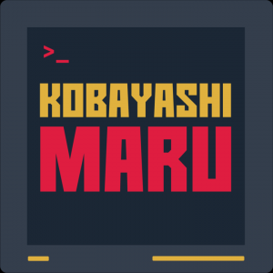


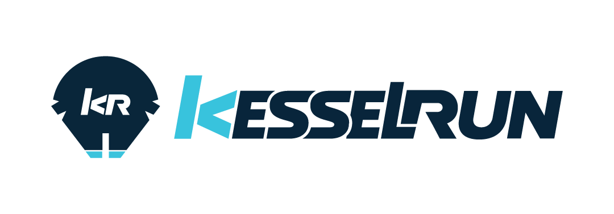

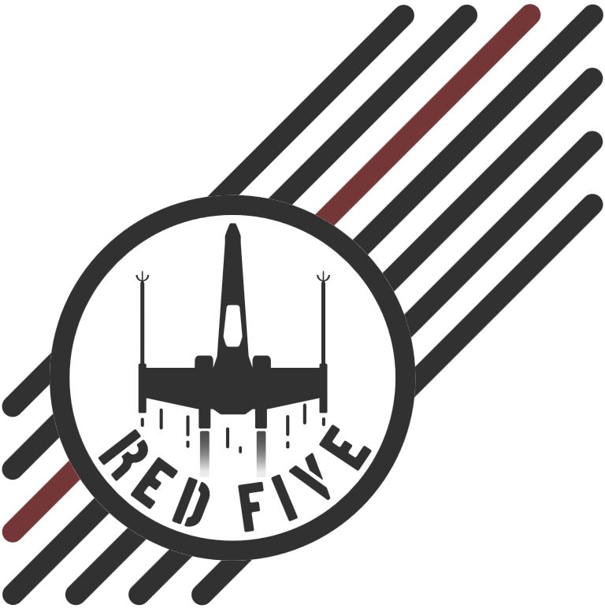
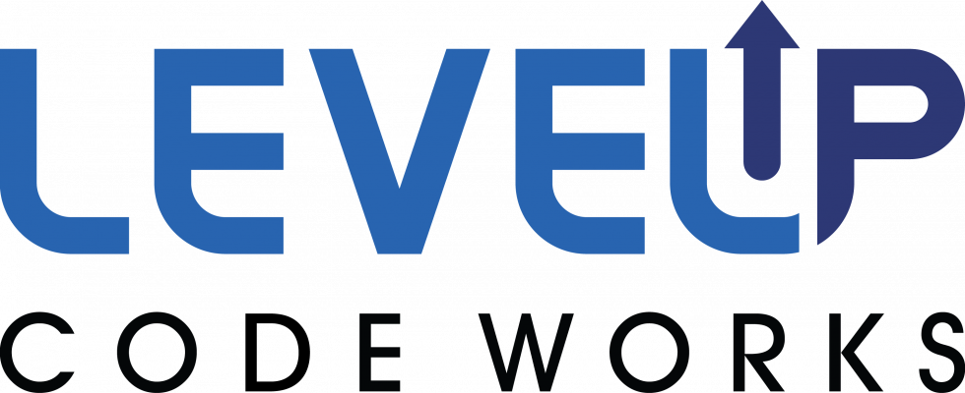
Platform: Software Toolchains, Pipelines, and Factories
TRON
PACOM
PEO Business and Enterprise Systems
MCBOSS – Marine Corps Business Operations Support Services
JAIC, Army Cyber, AEGIS, F-35
ABMS, and more
Department of Navy
Black Pearl
Navy
Overmatch Software Armory
Air Mobility Command
AOC, F-35, ABMS
Ski CAMP
Hill AFB
DGS-1 at Joint Base Langley-Eustis, VA

Slide 11
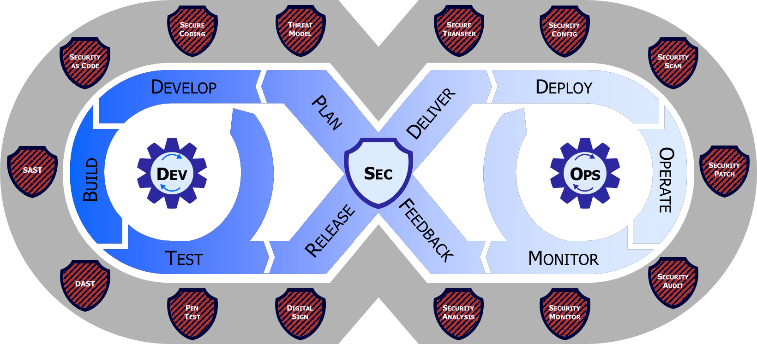
DevSecOps Process
Continuous Operations
Continuous Deployment
Continuous Delivery
Continuous Integration
Continuous Build
Plan
Develop
Build
Test
Release & Deliver
Deploy
Operate
Cybersecurity Automation (Scanning, Testing, & Validating)
Monitor
Legend
Control Gate
Risk Determination
Feedback Loop
Compliance, Effectiveness, ThreatCon, Malicious Detection

Slide 12
DevSecOps Maturity
Continuous ATO (cATO) enables bug and security fixes in minutes and provides rapid deployment of critical capabilities to the war fighter at the speed of relevance.
Continuous ATO
(cATO)
High
Difficult
DevSecOps
DevSecOps
Continuous Monitoring
Telemetry Capture
Service Mesh
Secure Containers
DevOps
Shift Cybersecurity Left
DevSecOps Capabilities
DevOps
Adoption Challenge
Continuous Integration
Agile
Agile, Microservices, Test Driven Development
Iterative with Hybrid or Monolithic Architectures
Low
Monolithic Architecture, Manual Processes
End to end cycle time – Design to Delivery
Brady Stark Smith Triangle of DSO Success

Slide 13
Continuous Authorization: Objective State for DevSecOps
AO’s
Organization
Authorize People, Process, Platform not each app developed
Team Assessors
Platform Assessors
Acquisition Organization
Teams
Platform
Prioritized investments in continuous improvement of the people, process, and platform to improve security
Platform
Team
DevSecOps
App Team
Specific
Pipeline(s)
Production
Environment
Decision
AO
Software Factory Processes
Continuous Risk Status Monitoring
Predictive, probabilistic cyber posture that is adaptable to changing mission needs
*Production Environment may be external to the platform
AO’s
Organization
Define Risk Posture & Associated Requirements
Process Assessors

