Slide 1
517th TRAINING GROUP | PRESIDIO OF MONTEREY, CA
Designing the Future Foreign Language Classroom
PRESENTED BY: MS. JULIE CANTWELL

Slide 2
517th TRAINING GROUP
Presidio of Monterey, CA
Strategy
Data Driven Gap Analysis
Research Through Design Thinking
OVERVIEW
Modernizing the Learning Model
Lessons Learned

Slide 3
STRATEGY
517th TRAINING GROUP
Presidio of Monterey, CA
START BY ASKING THE RIGHT QUESTIONS
How are our outcomes tied to our mission and vision?
What are the performance gaps?
What are our desired outcomes?
What data do we have to analyze the problem?
Ref: Clarke and Estes, 2017

Slide 4
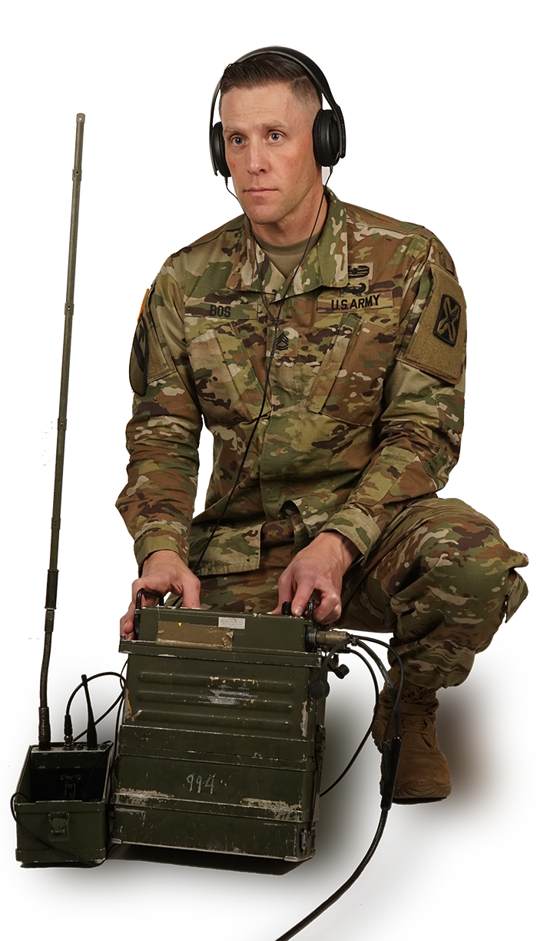
IDENTIFYING THE PROBLEM
517th TRAINING GROUP
Presidio of Monterey, CA
Cryptologic Language Analyst (CLA)
Multi-Disciplinary Language Analyst (MDLA)
We need…higher-order language analysis
in concert with regional expertise, cultural knowledge,
facility with technology, target-smarts, critical thinking, and more.
Amy E. Brown Gagnon / NSA/CSS Senior Language Authority Perspective (26 Aug 2020 CLPM Workshop)

Slide 5
IDENTIFYING THE PROBLEM
517th TRAINING GROUP
Presidio of Monterey, CA
WHY CHANGE CURRENT MODEL?
HIGH ATTRITION
24.9% (FY19, avg of all languages)
16.7% Academic
8.2% Administrative
1.2 to 2 Recruits per Needed Graduate
TIME
Current Time to Mission: 1-2 years
2+/2+ Post-DLPT Model: +3 months
Avg Enlistment: 4-6 years
MEETING FUTURE STANDARDS
FY19 Overall Post-DLPT Model
2/2/1+: 68.9%
2+/2+/2: 29.1% → 35-43% est.
3/3/2: 10.6%
HIGH COSTS (per student)
64 wk Course: $323K
8-14 wk Post-DLPT: +$50K
We Need to Increase the DoD’s Return On Investment (ROI)

Slide 6
DATA DRIVEN
GAP ANALYSIS
517th TRAINING GROUP
Presidio of Monterey, CA
PERFORMANCE GAP DATA ANALYSIS
QUANTITATIVE DATA
QUALITATIVE DATA
Notes:
Quantitative Data: 30 years of student data including grades, language choice, DLAB scores, DLPT outcomes, age, etc
Qualitative Year+ survey of attrited students to identify factors of performance and learning gaps. Focus groups for student, faculty, and administration feedback.

Slide 7
LIFELONG
LEARNING FOUNDATIONS
517th TRAINING GROUP
Presidio of Monterey, CA
CRYPTOLOGIC LANGUAGE ANALYST
Data-Driven Analysis
ACADEMIC CAUSES OF STUDENT ATTRITION AT DLI:
1
Inappropriate learning strategies (re-reading, cramming, exclusively bottom-up strategies, etc)
2
Inappropriate goals (performance vs proficiency goas, fear of failure, etc)
3
Poor self-regulation (lack of metacognitive knowledge, poor sleep, nutrition, exercise)
4
Poor motivation levels
Ref: Focus groups, interviews, and 30-year study (quantitative and qualitative data)

Slide 8
RESEARCH THROUGH
DESIGN THINKING
517th TRAINING GROUP
Presidio of Monterey, CA
DESIGN THINKING APPROACH TO BUILDING EDUCATION MODELS
FOCUS: WHAT CAN WE MAKE AN INTENSIVE LANGUAGE LEARNING PROGRAM LOOK LIKE?
Multi-dimensional 3-day event
Technologists, Educators, Operational CLAs, Students, Cognitive Scientists
Blend of industry, academia, and government
Ref: Bringing Design Thinking to Language Curriculum Design/Lee-Ellis & Burnhardt 2017
Notes:
Multi-dimensional 3-day event
Technologists, Educators, Operational CLAs, Students, Cognitive Scientists
Blend of industry, academia, and government

Slide 9
MODERNIZING THE
LEARNING MODEL
517th TRAINING GROUP
Presidio of Monterey, CA
LINGUIST NEXT
Language Classroom of Tomorrow
Utilize the most agile, flexible, & adaptable model--capitalize on best practices & advances in cognitive learning science and technology without time constraints
APPROACH

Slide 10
MODERNIZING THE
LEARNING MODEL
517th TRAINING GROUP
Presidio of Monterey, CA
STUDENT GOALS
Increase student production/successful graduation by at least 10%
Increase overall proficiency to the 2+/2+ level
Decrease time to desired proficiency level
Expose students to mission-related concepts & language at the earliest possible point

Slide 11
MODERNIZING THE
LEARNING MODEL
517th TRAINING GROUP
Presidio of Monterey, CA
PROGRAM ELEMENTS
Flexible & Individualized CURRICULUM
Integrated TECHNOLOGY
Proficiency ASSESSMENTS
Restructured STUDENT DAY
Notes:
Ref Carpenter 2012, Bandura 2013
Doyle & Zakrajsek, 2013
Bailenson
Kaplan et. al, 2020

Slide 12
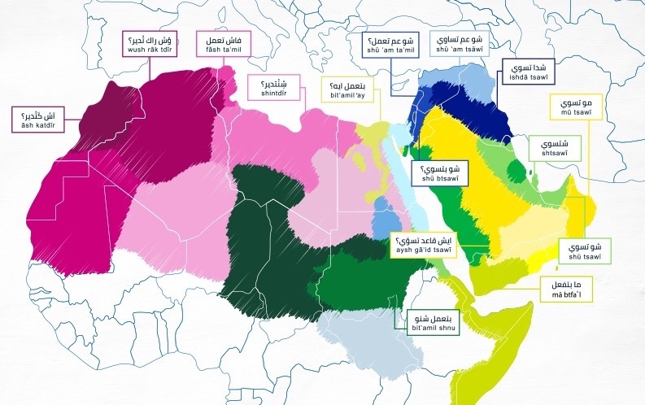
517th TRAINING GROUP
Presidio of Monterey, CA
FLEXIBLE & INDIVIDUALIZED CURRICULUM
Open Architecture Structure
Proficiency Advancement Activities
Account for Students’ Interests, Levels & Needs
Options-Based Choices
Adaptable Digital Format
Easily Updated as Language Evolves
Aligned to Individual Student Needs
Mission Skills Training
Critical Thinking
Reading Comprehension
Info Analysis
Linguistics
Transnational Dialect
Regional Dialect Recognition
Modern Language
Tech Terms
Common Vernacular
Slang
Culture & Region Lectures
Foundational Knowledge & Context
Delivered in English for Comprehension
↓
Foreign Language Overlay

Slide 13
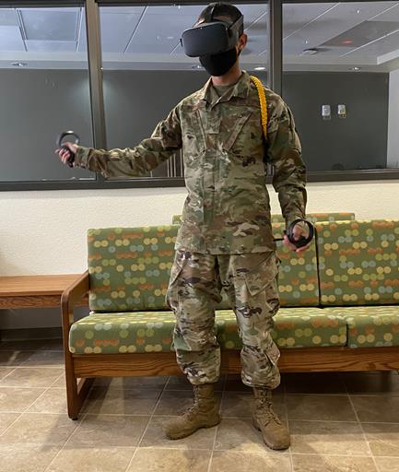
MODERNIZING THE
LEARNING MODEL
517th TRAINING GROUP
Presidio of Monterey, CA
INTEGRATED TECHNOLOGY
Increased
Language
Production
⇣
INCREASED PROFICIENCY
Human Language Technology
Review & Correct AI Translations
Reinforce Fluency & Contextual Knowledge
Practice Mission Skills
AFRL & NASIC Partnerships
Virtual Reality & Gaming
Immersive Environments:
Increase Oral Production
Practice Military Skills
Cultural Experiences
Peer-to-Peer Interactions
Gamification
Oculus: Maya Lingo / MageDuel
Personal Learning Algorithms
Tailored Feedback & Recommendations to Students
Automated Performance Reports
Shifts Teacher Focus to Engagements
Neuromodulation Study
Transcutaneous Vagal Nerve (tVNS) Stimulation
DARPA Partnership

Slide 14
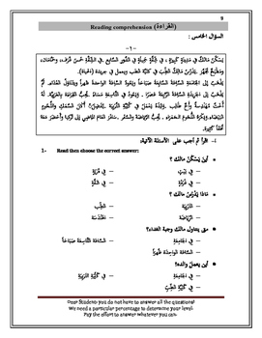
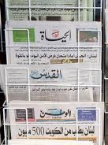
MODERNIZING THE
LEARNING MODEL
517th TRAINING GROUP
Presidio of Monterey, CA
PROFICIENCY ASSESSMENTS
Achievement
Performance
Proficiency
Academia
Best Practices
Collaborating with:
Univ of MD
Indiana Univ
UC Berkeley
USAFA / BYU
Automated Assessments
Help Teachers Quickly Adjust to Changing Student Needs
Continuous Feedback
Guides Individualized Learning Plans
Reduces Student Anxiety
Increases Confidence
Student Performance
Tied to
ILR Levels
Notes:
Ref Carpenter 2012

Slide 15
MODERNIZING THE
LEARNING MODEL
517th TRAINING GROUP
Presidio of Monterey, CA
RESTRUCTURED STUDENT DAY
LEARNING
SCIENCE
AA
APPROVED
SCHEDULE
to Maximize Learner Outcomes
Decreases Cognitive Load
Health & Welfare Built-In
Decreases Physical & Emotional Stress
Increases Learning Resiliency
Synthesized Military & Language Training
Activity Scaffolding
Increases Metacognitive Awareness
0700-0800: Military Time
AM
0800-1100: Coursework
MID DAY
1100-1230: PT / Military
1230-1400: Lunch, Study
1400-1600: Coursework
PM
1600-1700: Military Time
1900-2030: HW / Study
Notes:
Ref Carpenter 2012, Bandura 2013

Slide 16
MODERNIZING THE
LEARNING MODEL
517th TRAINING GROUP
Presidio of Monterey, CA
FACULTY DEVELOPMENT
INDIVIDUALIZED training on topics of need and interest
FOCUS on innovation and iterative design
COLLABORATION between DLI, Air Force and greater academia/industry
OPPORTUNITIES for research and publishing
Notes:
Reference Kirkpatrick & Kirkpatrick, 2016

Slide 17
LESSONS LEARNED
517th TRAINING GROUP
Presidio of Monterey, CA
GROWTH BEGINS WITH:
COLLABORATION
Key to Get the Best Outcomes—having the academic humility to partner in order to change how we do business
TECHNOLOGY
Not the Panacea—how we integrate technology to reach the right learning objectives is more important
LEARNER FEEDBACK
Vital to the Iterative Design Process—when students own their learning, the improved results follow in the classroom and beyond
FACULTY DEVELOPMENT
Must Be Robust--student-centered/individualized learning requires sophistication by the educator/trainer

Slide 18
LESSONS LEARNED
517th TRAINING GROUP
Presidio of Monterey, CA
BE PREPARED FOR:
LACK OF RESOURCES
Have plan B-Z ready in the event that you run into a resource constraint; focus on scalable solutions to the ID’d problem
DELAYS AND RESISTANCE
Not everyone will be a fan; build a support network to sustain you and your team through the project; decide which elements are the must-do’s vs. the nice-to-do’s up front
TEAM BUILDING CHALLENGES
Build the team’s culture from the beginning and return to the shared values construct when conflict arises
ADAPTATION
Keep the Design Thinking/Agile principles in mind, and flex when new data presents itself

Slide 19
PRESENTATION TITLE
517th TRAINING GROUP
Presidio of Monterey, CA
Strategy
Data Driven Gap Analysis
Research Through Design Thinking
SUMMARY
Modernizing the Learning Model
Lessons Learned

Slide 20
517th TRAINING GROUP | PRESIDIO OF MONTEREY, CA
QUESTIONS
PRESENTED BY: MS. JULIE CANTWELL, 517 TRG TECHNICAL DIRECTOR

