Slide 1
The Flight Commander’s Edge Video
Notes:
(00:00 – 03:36)
Danielle -- Play this video at 09:56am
https://youtu.be/iO4QwsjIw0I
When it is over, we will launch into the presentation.
*We will also save/play again at the end

Slide 2
Speakers (Hidden Slide)
Before Break
After Break
Welcome (5 min) - Courtney
Pre-Work and Takeaways (5 min) - Courtney
Breakout Session (15 min) - all
What is The Flight Commander’s Edge (5 min) - Courtney
Flight Commander Leadership Course (10 min) - KV
How do lessons work? (10 min) - Mike
Break (10 min)
Designing a Flight Commander Leadership Course (10 min) - Mike
Breakout Session (20 min)
Debrief (10 min)
Preparing for Execution (5 min) - Courtney
Q&A (10 min) - Courtney/All
Help? The FCE Community (5 min) - KV
Closing - Courtney

Slide 3
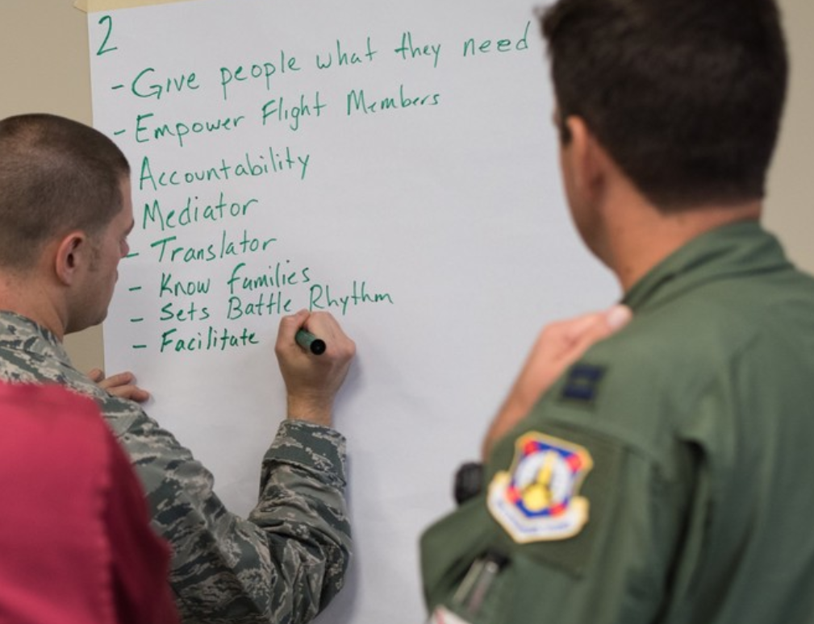
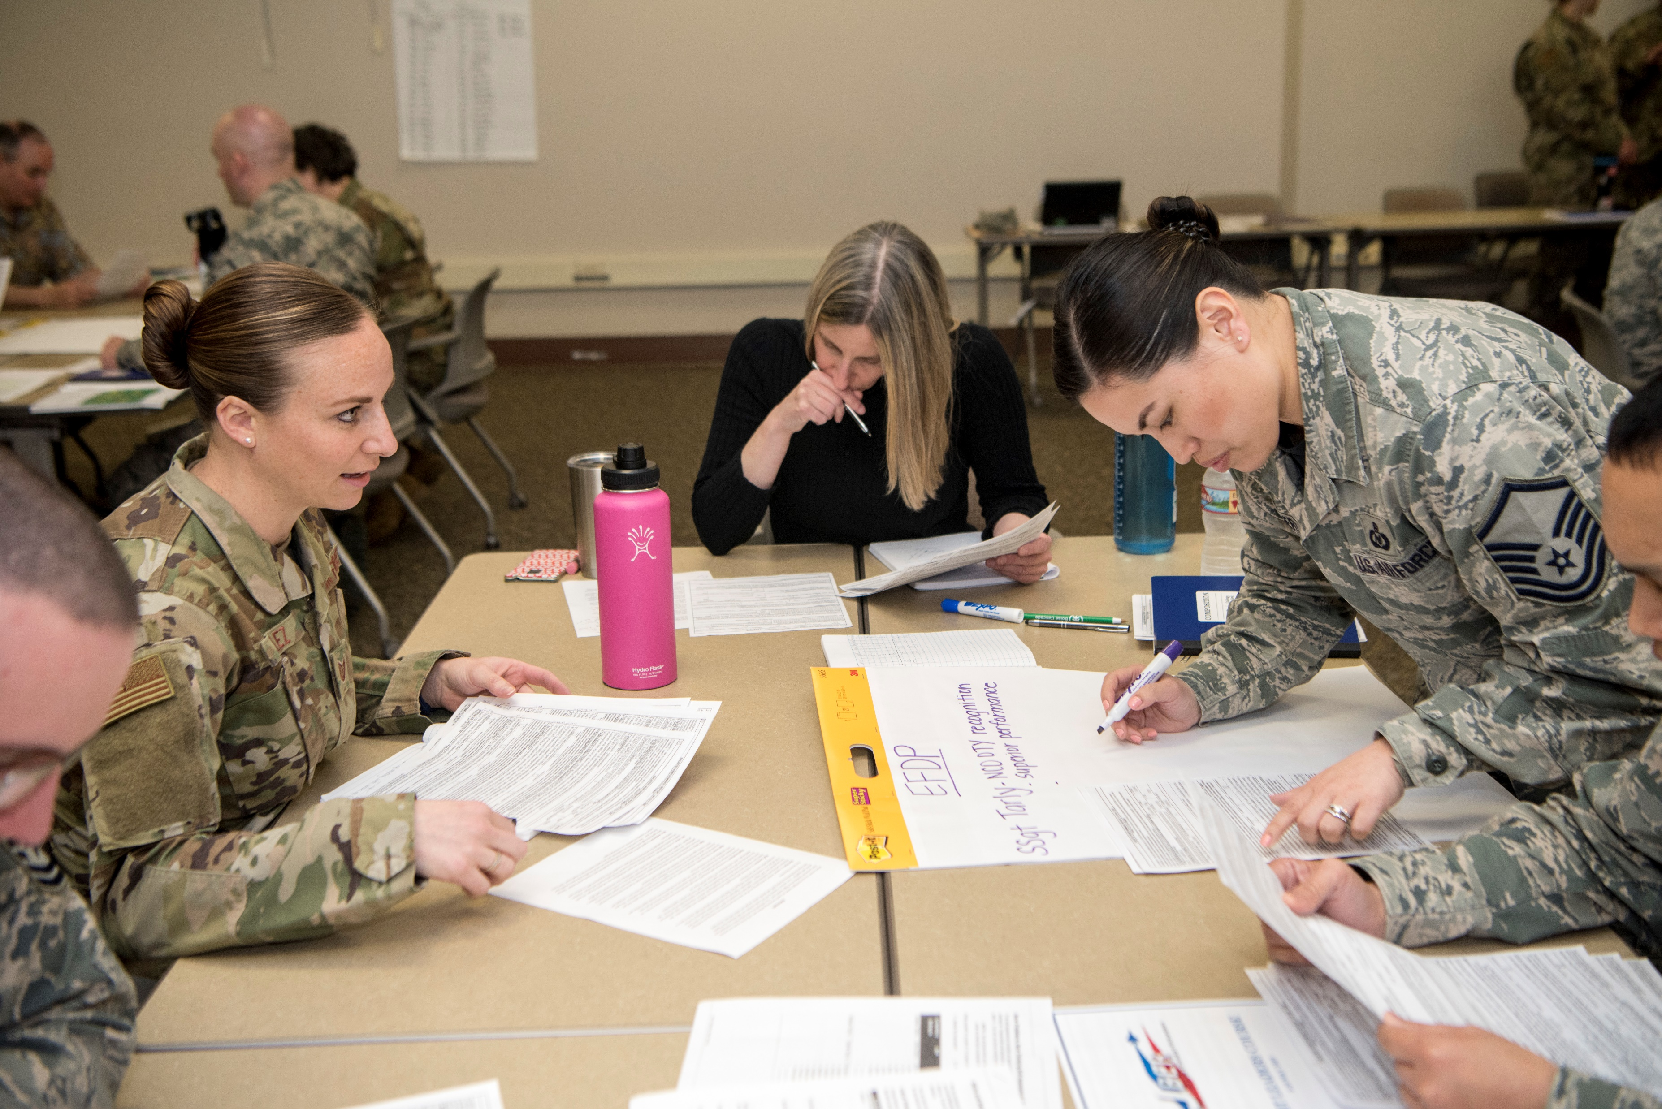
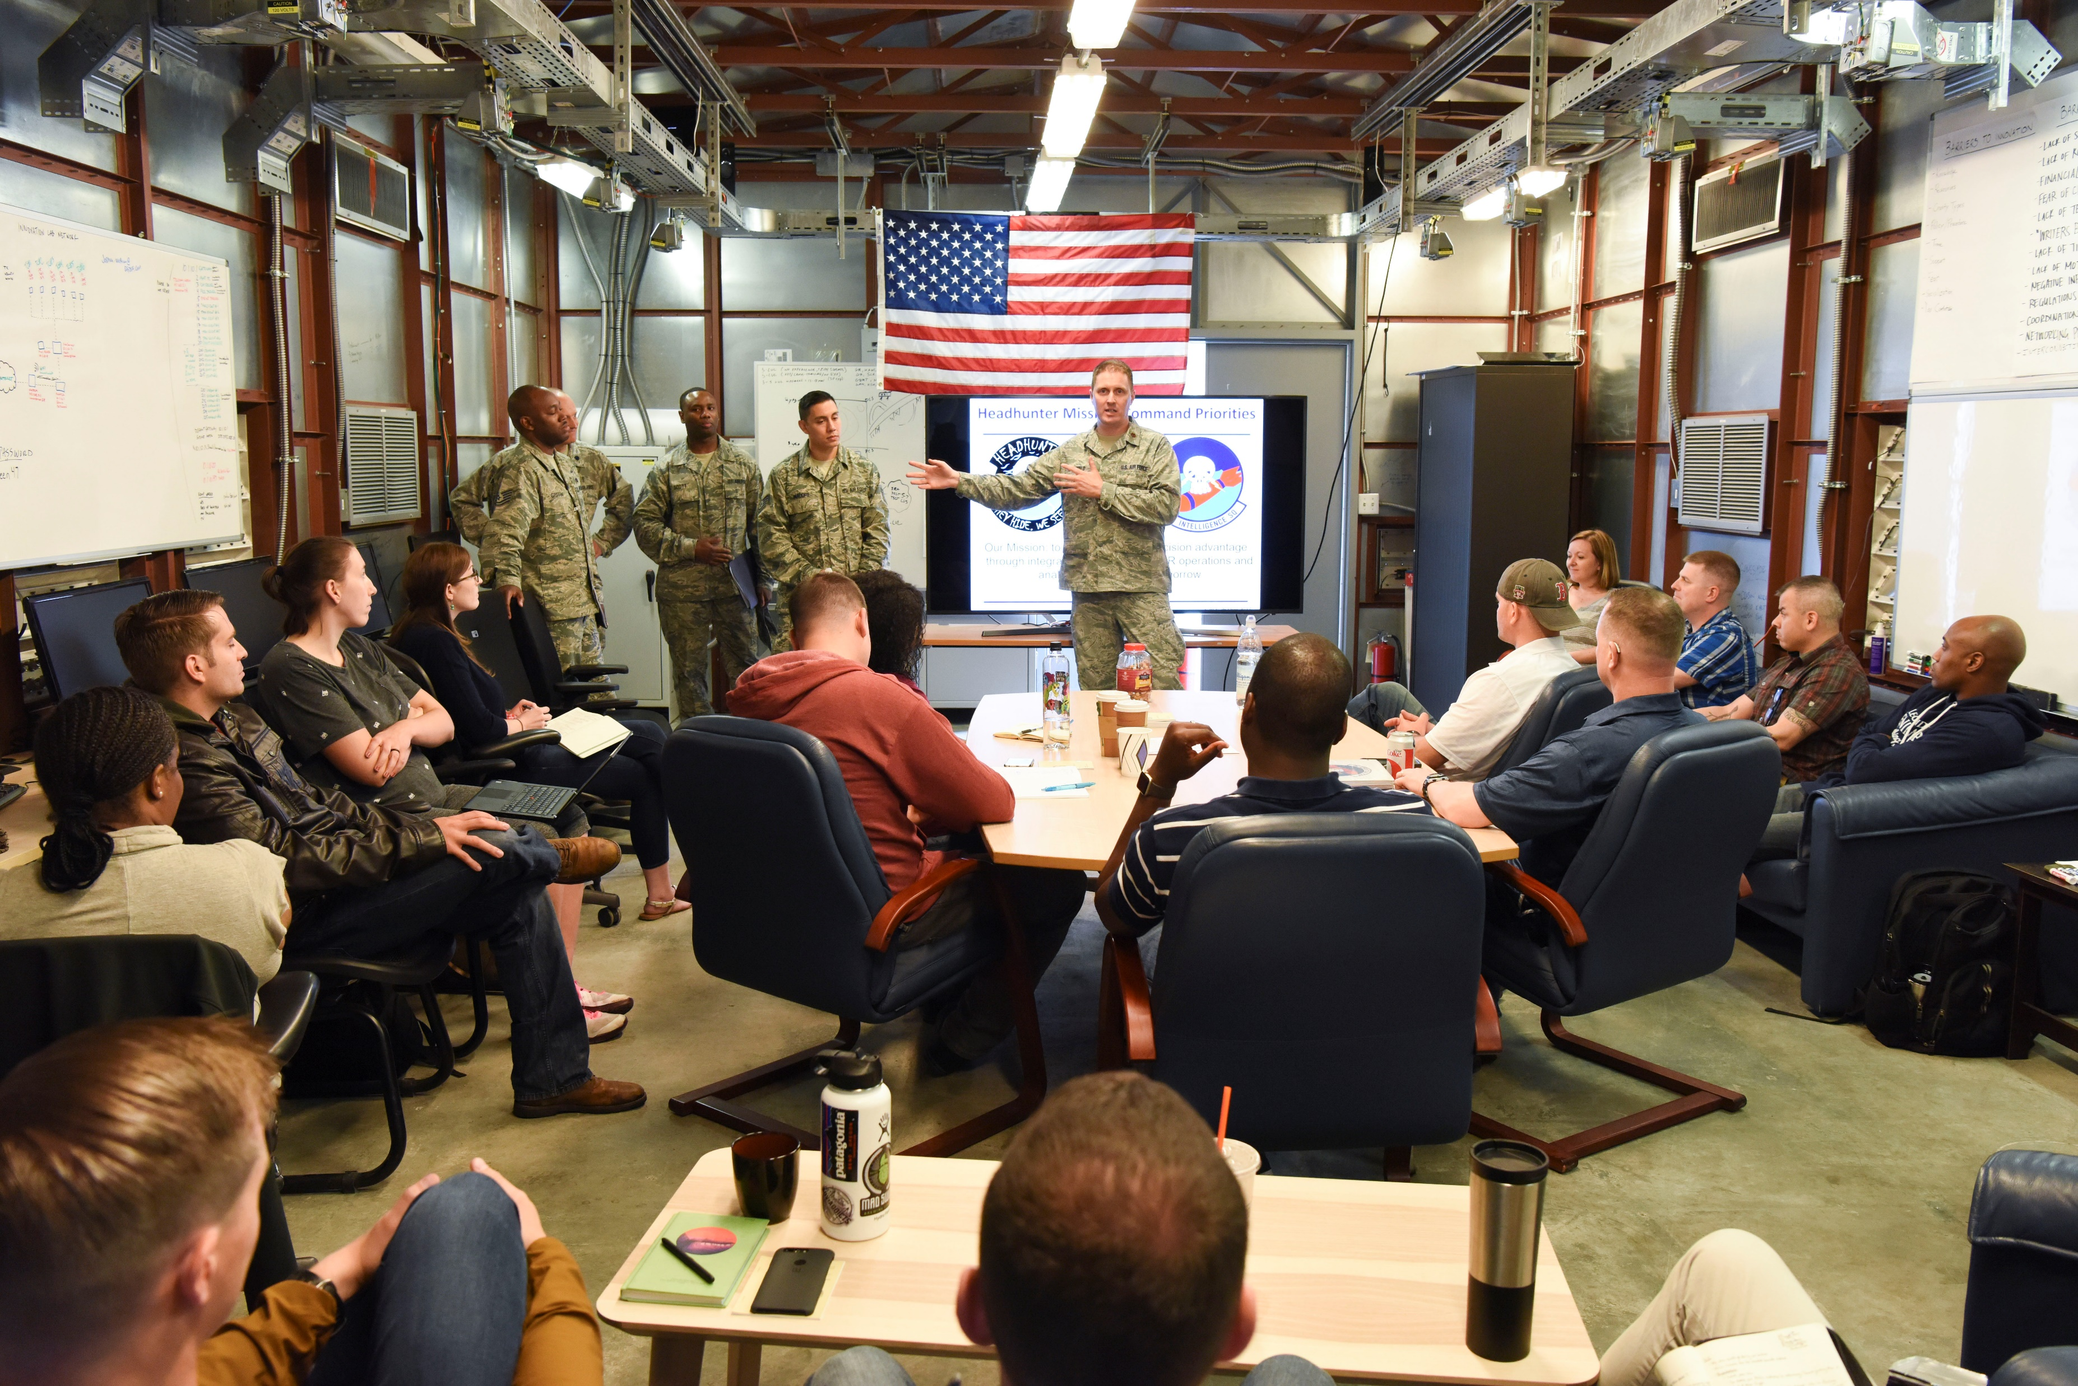
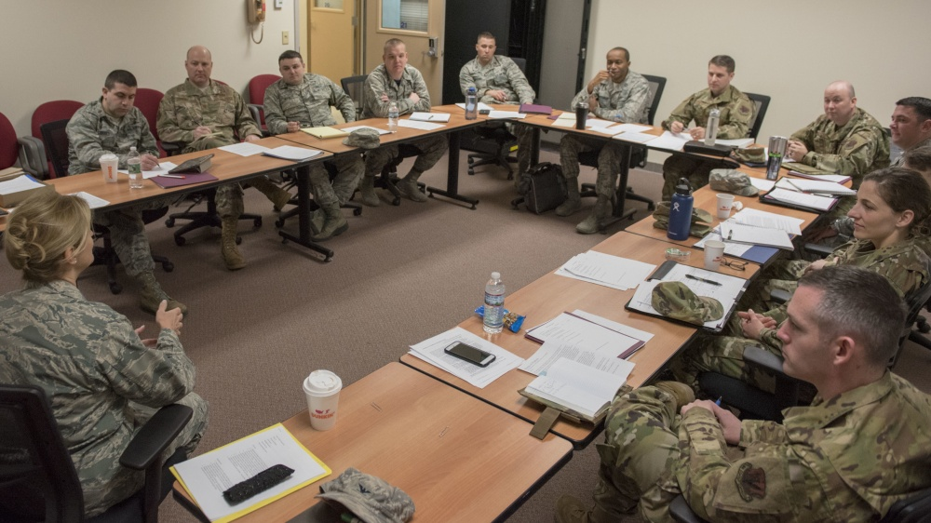
Just Add Leaders: Building a Flight Commander Course
23 March 2021
Notes:
(00:00 – 00:43)
Good morning everyone!
I'd like to welcome you to today's workshop – Just Add Leaders: Building a Flight Commander Course.
My name is Maj Courtney Scott, and over the next two hours – my team and I are going to share with you a simple, step-by-step method for you to build a highly-effective, in-house flight commander course for your unit.
And the key thing – you don't need to be an educator or an expert instructor to do it. Our approach is designed for you to "Just Add Leaders" -- and perhaps a bit of elbow grease – and you will have a highly-effective flight-level leadership program custom tailored to your organization, in a fraction of the time building or coordinating a normal course would take.
------------ (next slide)

Slide 4
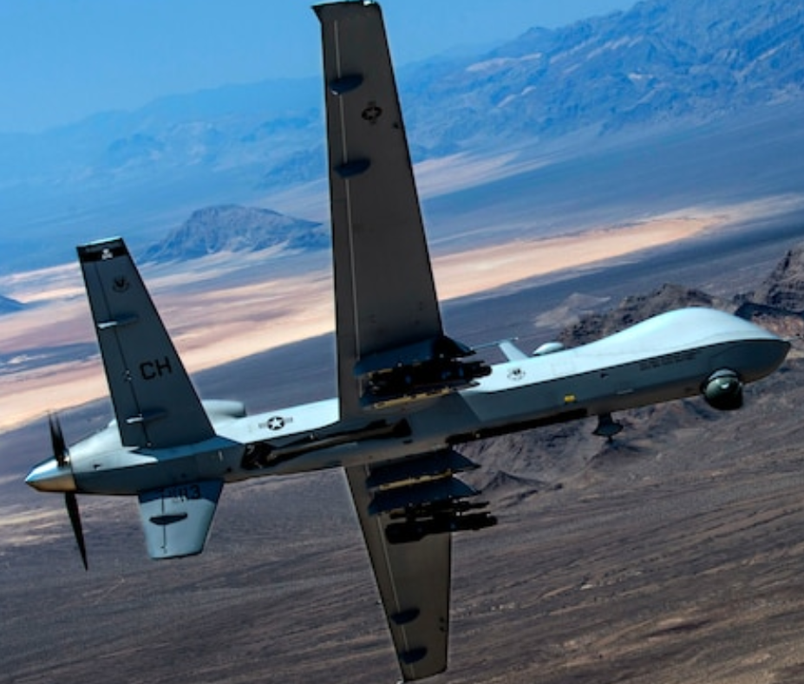
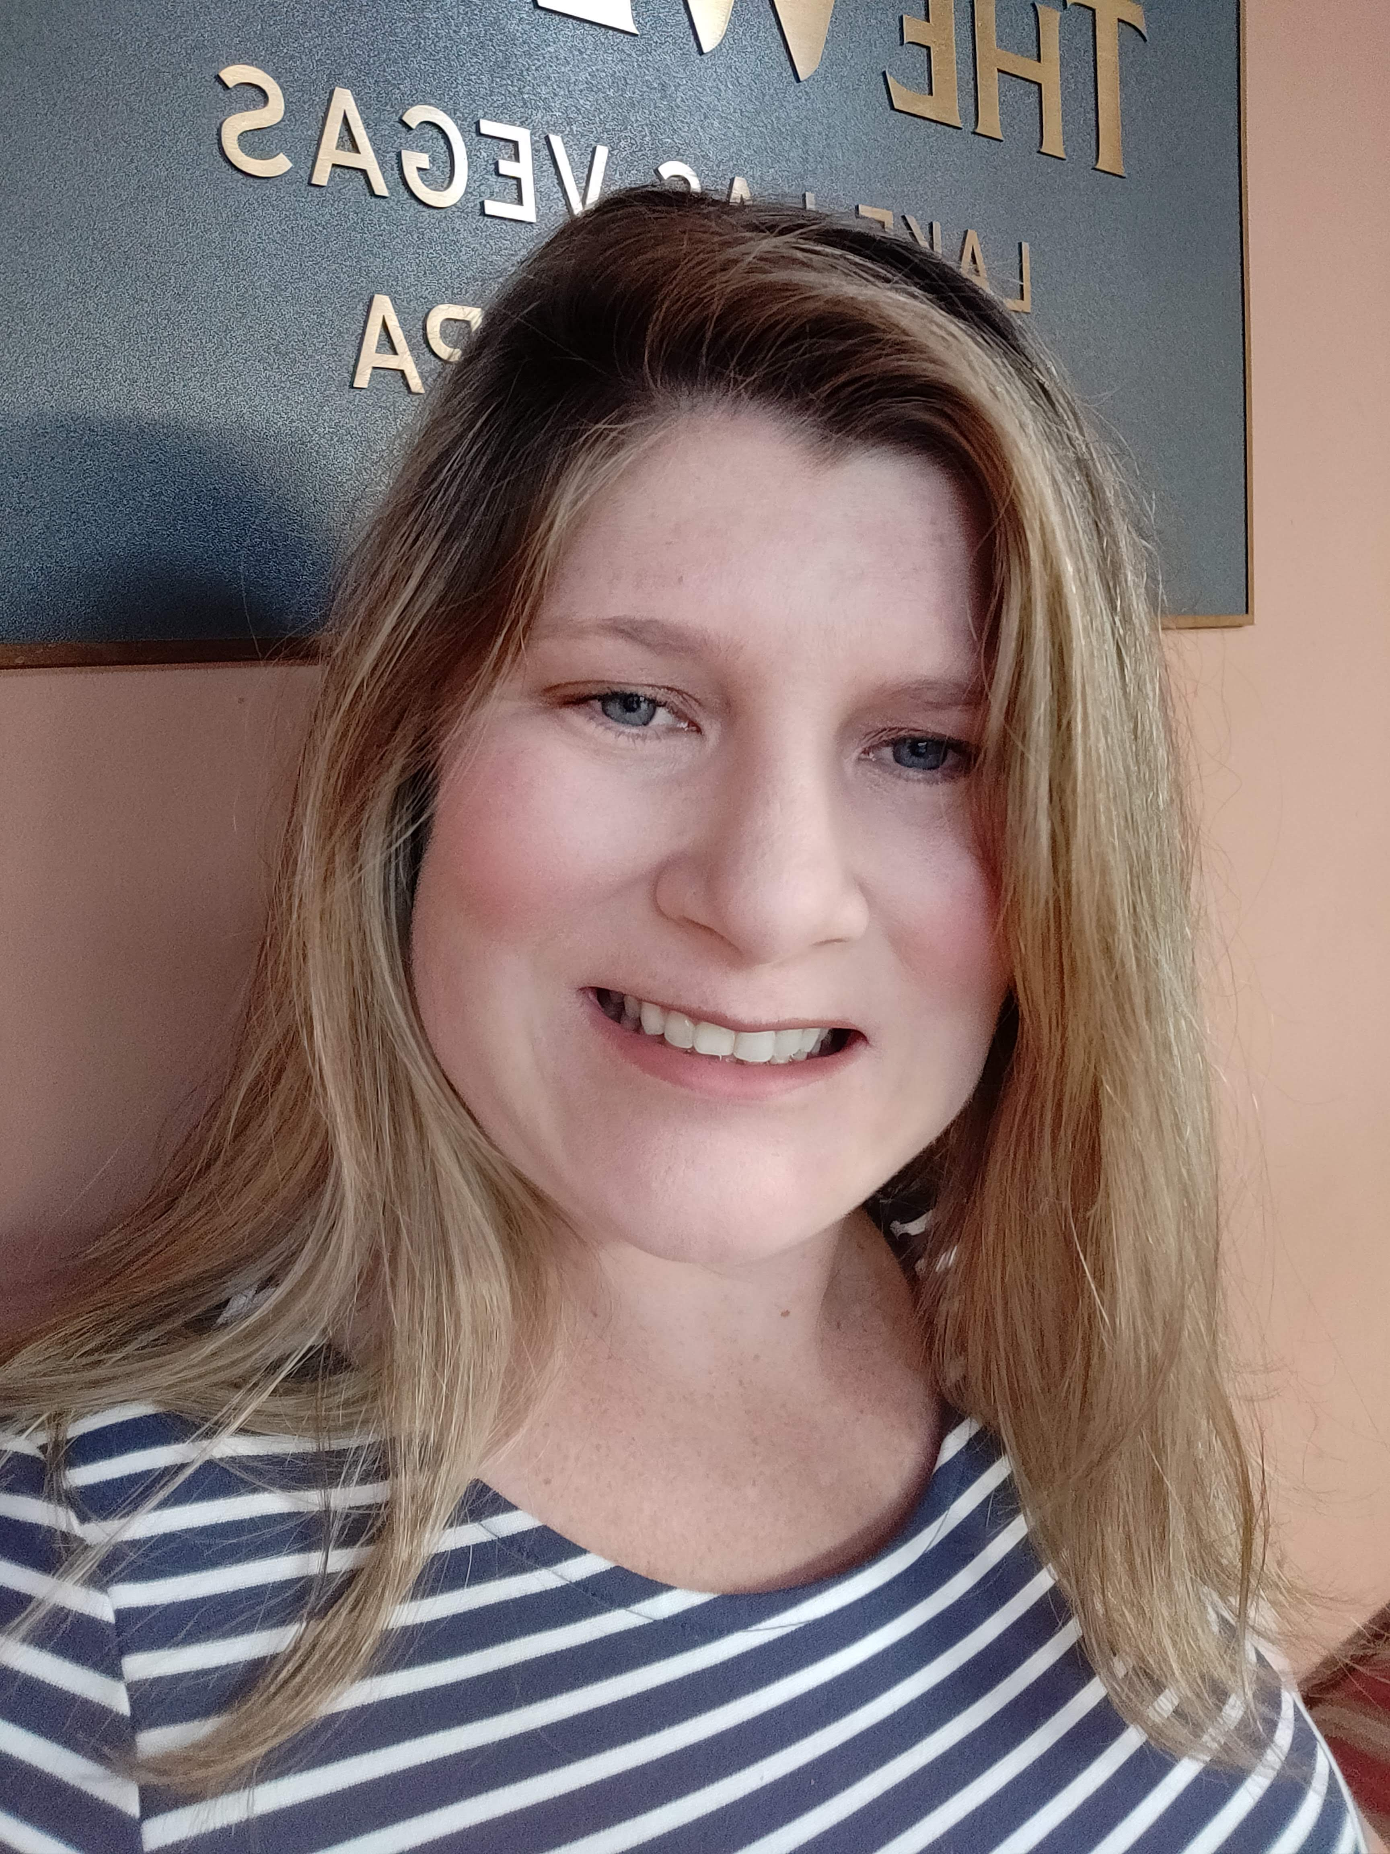
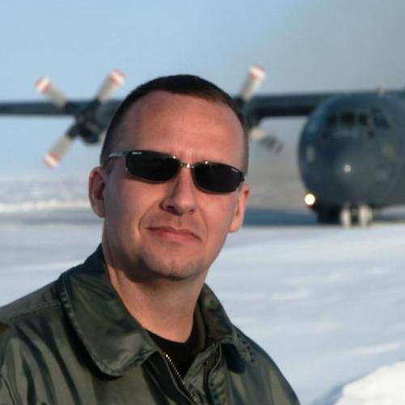
Welcome from your FCE team!
2
Mrs. “KV” Knutson-Vaccaro
(Maj USAF, ret)
1
3
Mr. Mike Hower
Lt Col USAF, ret)
Major Courtney Scott
Notes:
(00:43-02:35)
Before we get started, I'd like to introduce the Flight Commander's Edge – or FCE -- Team.
As I mentioned earlier, I'm Maj Courtney Scott, the FCE Program Director at Air University. I am a pilot who has flown C-17s, MQ-1s and MQ-9s. I now work in the leadership department at the eSchool of Graduate Professional Military Education or “PME” – that's the Air University school responsible for all online officer education – at Maxwell AFB, Alabama.
Presenting with me today are Ms. Carolyn Knutson-Vaccaro or "KV" for short, and Mr. Mike Hower.
KV is a retired Air Force major who also happens to be a prior enlisted Marine and a graduate of their Senior NCO PME program. She brings a different "lens" to our leadership development efforts. Today, she serves as the manager of the FCE online community. KV is happy to call Alabama home as both of her children attend college in the state.
Mike is a retired Lt Col who currently works as the strategic advisor for the eSchool of Graduate PME and travels from place to place in his RV. In 2018, he developed the experiential method we use in the FCE program – that's the key reason you can "Just Add Leaders" to create a good course.
I'm thrilled to have both of them on my team, and they will be sharing the stage with me here today as we walk you through the process of building your own leadership development program.
Also, in our breakout groups, you will be meeting Dr. Chris Shannon and Maj Travis Neal. Dr. Shannon is a leadership educator at Air University, and Maj. Neal, a KC-135 pilot, is the lead for curriculum development for the new distance learning enlisted PME program at AU.
Over the next two hours.... (transition to overview slide)

Slide 5
Overview
By the end of this workshop, you will:
Understand the commander’s prerogative for strengthening the squadron at flight-leadership level
Explain how The Flight Commander’s Edge enables leader development
Describe the Flight Commander Leadership Course design framework
Appreciate how the Experiential Learning Model enables informal learning
Apply/adapt AU-provided materials to design your own Flight Commander Leadership Course
Prepare for execution of your own course at home station
Notes:
(02:35 – 03:50)
…we are going to walk you through a workshop – a virtual workshop – just like we would do in person.
The FCE program is all about strengthening the squadron at the most important and difficult level of leadership – the junior level.
Our program allows you to quickly determine your unit's leader development needs and design a custom, tailored-to-you course using a framework that makes it easy to build a program in minimal time.
The key thing about the FCE methodology is that it is experiential –
meaning that you don't need to be an expert in leadership to teach any of the AU-provided lesson plans.
You can just follow the plan, using the provided slides and handouts, to produce good results.
No matter your experience level – or the level of experience of your audience –
you will produce positive results which teach key leadership concepts and behaviors based on the experiences of others.
And finally, we will actually walk you through the process of organizing your own course using AU-provided materials and
preparing it for execution at your home station using the outline you will develop here.
However, before we get started...

Slide 6
Agenda
Theory
Practice
Welcome (5 min)
Pre-Work and Takeaways (5 min)
Breakout Session (15 min)
What is The Flight Commander’s Edge (5 min)
Flight Commander Leadership Course (10 min)
How do lessons work? (10 min)
Break (10 min)
Designing a Flight Commander Leadership Course (5 min)
Breakout Session (25 min)
Debrief (10 min)
Preparing for Execution (5 min)
Q&A (10 min)
Help? The FCE Community (5 min)
Notes:
(03:50-5:00) ...let's briefly look at the agenda for today.
This is also in your workbook on page 4.
The workshop is divided into two parts.
Before our break, we will focus on the foundations of the FCE program – what it is, why it works, and how it works.
We will also have a brief breakout session for you to meet your group facilitators and talk about the pre-work we asked you to complete.
If you didn't have a chance to complete the pre-work, don't fret...we anticipated that some of you wouldn't...
so this session will serve to give you the information you need to succeed throughout the rest of the workshop.
After the break, we will dive into the actual design of your own course.
We will have our second, longer breakout session where you will work with your facilitator to complete the course design worksheets in your workbook, and then we will come back together and talk about what you need to do to actually teach your course at your home station.
Of course, will have plenty of time for Q&A at the end, and send you off with the support of the FCE community available online.

Slide 7
Administration
“The two most powerful warriors are patience and time.”
- Tolstoy
Cameras and microphones
Breaks
Breakout sessions
Parking lot for ideas
Notes:
(05:00-06:00)
Let's also briefly cover some administration points.
Please leave your cameras and microphones OFF during the large group presentations.
If you need to ask a question, please do so in the chat – we will have someone monitoring the chat for follow-up.
As you saw on the agenda, we have one break scheduled for the session – right about half-way through.
However, we will also have two "breakout sessions" to work in small groups throughout the workshop.
Often, you will have extra time during those sessions to take care of business.
During the breakout sessions we ask that you turn your cameras and audio ON so you can build a relationship with the people in your "team."
You will remain in the same team for the duration of the workshop.
Finally, if you have questions that don't directly fit into the session, they will be moved to a "parking lot for ideas“ by the chat monitor, which we will try to loop back to at the end of the workshop as we have time. Any of the questions we don't get to during the event will be answered in the FCE community online after the event.
Questions? I'll pause here for a moment and see if there is anything in the chat....
(answer questions as required)
Ok, let's get started...

Slide 8
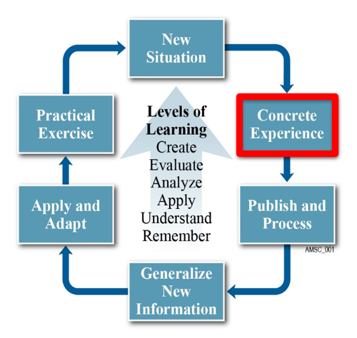
Workshop Part I
Getting Started
Notes:
(00:00-00:11)
Are you ready? Let’s get started with Part 1.
You can follow along with the presentation in your Workbook. Just turn to the section labeled "Part 1" beginning on page 5.

Slide 9
Getting Started
Pre-work Instructions
Course Workbook
→ https://tinyurl.com/FCEPrework
PDF → https://tinyurl.com/FCEWorkbook-v6-PDF
Word → https://tinyurl.com/FCEWorkbook-v6-Word
Notes:
(00:11-02:00)
When we sent out the invitation to this workshop, you received some pre-work instructions.
In a more recent email, you received your workbook for the workshop. Let’s talk about each of these things for a minute.
The pre-work provided you some actions to take BEFORE we started today and submit it via our website. You will see why very soon.
The workbook we sent you yesterday serves two purposes:
First, it serves as the notetaker for you throughout the event. There are several worksheets in Section 1 that we will ask you to fill in individually and in your breakout groups during the event today.
Second, the last section contains a Checklist for Success which will guide you to apply the work you've started here and actually conduct your own workshop at home.
If you haven't printed out at least the workbook yet, please do so now – or open it up on a second screen so you can see it and us at the same time. If you don't have any of these items, you can re-download them from the links here or in the chat.
(NOTE to Mike, please load the links to the slides into the chat when this slide comes up.)
I will pause a few seconds and give you an opportunity to download or find your own local copies before we continue.
(Courtney, wait about 20 seconds and then continue.)
Ok, lets move on. Again, those documents are available in the chat if you haven’t been able to get them so far.
Now, lets take a look at that pre-work....

Slide 10
Pre-Work Activities
Watch video
Review FAQ
Conduct an interview
Submit results via poll
Sign up for the FCE Community
← Course Preparation Activities
← Key Tools for Success
Notes:
(02:00-03:00)
We asked you to:
Prepare for the workshop by viewing the FCE introduction video
Review our FAQ on FCE and the genesis of the Flight Commander Leadership Course
Schedule and conduct an interview with your commander (or other potential course-sponsoring leader)
Submit your interview results in a pre-course poll, and
Sign up for the FCE Canvas Community
The first three activities were designed to make you smart about the FCE program and get you ready for the in-class activities.
The second two activities were designed specifically to set you up for success in today’s workshop.

Slide 11
Breakout Exercise
Breakout Group Slide I-1
Given:
Your interview results
The FCE Course Director Workbook
Get to know your facilitator…and answer this question:
What are the most important topics for flight-level leadership development?
15 Minutes
Notes:
(03:00-04:30)
So, why did we do this interview and survey? There are two main reasons:
The first and most important (and most often overlooked) thing in creating any kind of leadership development program is "the need."
Does leadership perceive a need for such a program? From your interview results, the answer is clearly "yes."
The second most important thing closely follows the need – and that is "the requirement."
Through your interviews, you received your commander's guidance on what a program should be in terms of length and what it should cover.
Together, these things are essentially your "Commander's Intent" for leader development at the flight level.
The next step is to make sure that you understand this intent, and that is the purpose of our first breakout session.
In this 15-minute exercise, you will go into your small groups, briefly get to know each other, and come up with an answer to this key question: WHAT ARE THE MOST IMPORTANT TOPICS FOR FLIGHT-LEVEL LEADERSHIP DEVELOPMENT?
You will need to be able to answer this question to continue with the workshop. However, as we mentioned earlier, if you didn't get an opportunity to conduct an interview, this is your opportunity to pull together the guidance you will need – based on the perspectives of other people in your group – to complete the workshop.
Then we can start building.
Ok, let's split off to our groups. The first time we do this, it will take a little longer to get you all situated...and then we will bring you back at the 15 minute point.

Slide 12
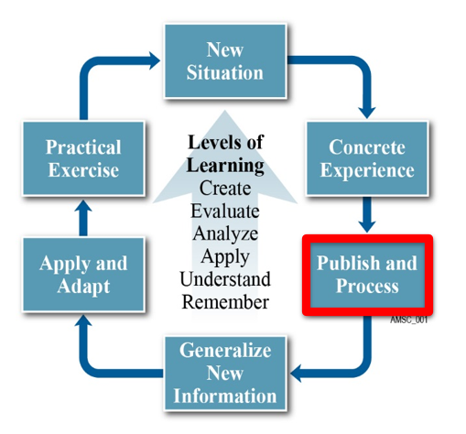
Go to Breakout Groups
Return here in 15 minutes…
Notes:
(NOTE: Tell Danielle to begin the move process.)
Alright Danielle, please go ahead and start the “move” process.

Slide 13
Breakout Exercise
Breakout Group Slide I-1
Given:
Your interview results
The FCE Course Director Workbook
Get to know your facilitator…and answer this question:
What are the most important topics for flight-level leadership development?
15 Minutes
Notes:
Note to Facilitators:
Introduce yourself to your group
Do a brief round-the-group exercise; perhaps asking for name, unit, and whether they have a flight-level leadership development program already in place.
Get quickly to the main question.
If desired, use the next slide to keep the group on track.
Also, if you have a student who does not have polling results, you may want to share the info on slide 16 as the results of a sample interview with a Wing/CC (Laughlin AFB).

Slide 14
Group Instructions
Discuss the results of YOUR interviews, and answer:
What are the most important topics for flight-level leadership development?
What must ABSOLUTELY be covered for a course in your unit?
Record your thoughts in your workbook
Notes:
Facilitators: Page 29 for quick reference list of lessons in workbook
Pgs. 30-31 in workbook short summary of lessons and what they entail.

Slide 15
Sample Topics from a Wing Commander
Most Important Topics:
Roles and Responsibilities
Conflict Management
Effective Communications
Mentoring
Problem Solving/Decision Making
Team Building/Team Leadership
Specific Problems to Address:
Team Building
Focus:
CGO
Flight-level Enlisted and Civilian Leaders
Length:
5 days
Wiling to speak?
Yes
Notes:
Note to Facilitator:
This chart is available as a PDF download at the following link: (Mike will insert once charts are finalized)
If needed, share this link with your group in the breakout group chat.

Slide 16
Return from Breakout Groups
Picking up where we left off…
Notes:
(Note: Danielle will add a two-minute warning into each group, then bring the groups right back to Part II.)

Slide 17
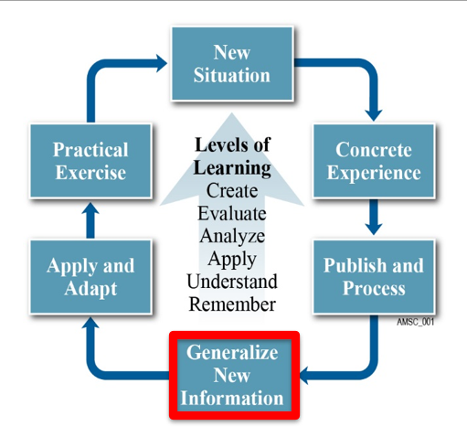
Workshop Part II(A)
What is The Flight Commander's Edge?
Notes:
(00:00-00:20)
Welcome back!
I hope you found the breakout sessions useful to you.
You will get a chance to apply that information later in the course as you start building your own course outline.
For the next 20 to 30 minutes, we will look at the FCE program. What it is? How it works? and Why it works?
Let’s start with a brief intro as to how we got to where we are today....

Slide 18
What is The Flight Commander’s Edge?
Notes:
(00:20-00:55)
The Flight Commander’s Edge is a program established by The Air University and managed by the eSchool of Graduate PME to support the development of flight commander courses across the Air Force and Space Forces.
FCE is also an online community of practice where flight commander course directors can come to connect with peers, share ideas, and ask questions. Staffed with professional flight-level leadership experts, the community is the place to ask questions about flight commander-level topics.

Slide 19
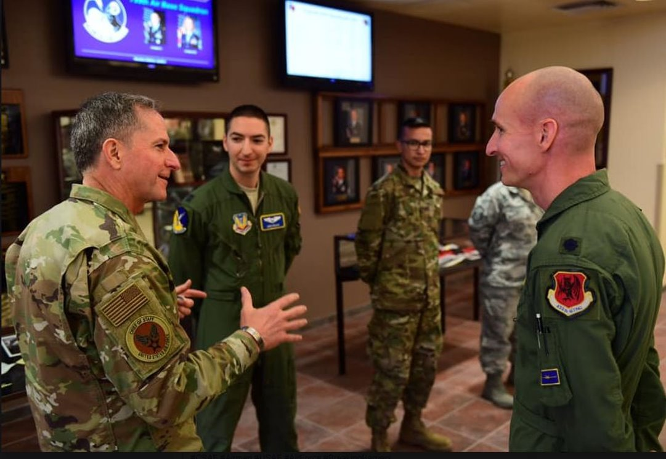
Why was the Flight Commander’s Edge Established?
SECAF/CSAF/CMSAF memo (1 June 2018)
“Squadron Revitalization Implementation Plan”
“Wing Commanders will establish Flight Commander/leader courses focused on key skills needed to succeed in this first essential level of leadership. AETC will offer course content options but Wing Commanders will have ownership of the curriculum.”
AU to “Develop initial set of course materials for a Flight Commander development course, which Wings can modify and package into Wing-level courses.”
Notes:
(00:55-01:55)
The program was the idea of then Chief of Staff General Goldfein in 2018.
His "Squadron Revitalization Implementation Plan" directed all wing commanders to establish flight commander/leader courses needed to succeed in "the first essential level of leadership."
AETC was tasked to provide course content, but the wing commanders – as the ones ultimately responsible for development of personnel at the local level – would retain control of the curriculum.
AETC turned to Air University...specifically the eSchool of Graduate PME as the Air Force's leading experts in presenting education at a distance...
to develop the methodology and the core curriculum.
The result was The Flight Commander's Edge program we have today...implemented in November 2018.
We are now on our third year, and rolling out even more "leadership goodness" across the Force.
And that's where you...and this workshop come in.

Slide 20
What is the Flight Commander's Edge Workshop?
Not everyone has access to a Wing-sponsored course…
Allow local units to host their own flight-level programs
Provide resources
Cast a wider net across the force for sharing resources
WORKSHOP
Notes:
(01:55-02:45)
While FCE was designed for Wing Commanders to host their own flight-level leadership programs,
it turns out there are a lot of folks out in the Air Force and Space Forces who don't necessarily have ready access to a Wing-sponsored course.
We discovered this when individuals and units not-at-the-wing-level would contact us asking if they could run their own FCE programs.
We said "Why not?" and the idea for this workshop was born.
Through the workshop, anyone at any level can – with leadership support, of course –
host their own flight level leadership program using the same model and resources provided by Air University to wing commanders.
And, it will also allow us to cast a wider net – through the FCE community – to gather and share resources across the force.
And we think that is a good thing.

Slide 21
What is a Flight Commander Leadership Course?
Goal 1
Improve understanding of flight commander roles, duties, and responsibilities
Goal 2
Increase proficiency in key flight-level leadership skills and behaviors
Goal 3
Orient flight commanders on unit policies, programs, plans, and procedures
Notes:
(02:45-03:50)
So, what exactly is a Flight Commander Leadership Course, or FCLC?
(PAUSE)
An FCLC is designed to be a 2- to 5-day experiential opportunity for new flight commanders, or similar level leaders, which provides an opportunity to focus on practical leadership development at the unit or team level.
A FCLC is designed to do three key things:
Improve understanding of flight commander roles, duties, and responsibilities.
Increase proficiency in key flight-level leadership skills and behaviors, AND
Orient flight commanders on unit policies, programs, plans, and procedures.
That's it. It's pretty straightforward, but it fills an important need.
Most flight-level courses today primarily focus on policies and procedures, not necessarily leadership.
And leadership is what we need to be successful in today's complex world – that's why it is at the heart of The Flight Commander's Edge.

Slide 22
Why Focus on Leadership?
Most in-the-field courses focus on policy and procedure orientation
Leadership instruction = missing
FCLC = best of both worlds A tailored flight-level leadership development experience designed to improve overall performance
Notes:
(03:50-05:00)
Why do FCLCs focus on leadership?
Well, first...because we were told to by the CSAF.
But more importantly, our own research found that many existing flight commander courses served primarily as an orientation course.
These courses do a good job at orienting a new flight commander to MAJCOM/NAF/Wing/unit policies and available base resources, but they lack structured leadership instruction and application practice.
A FCLC combines the best parts of existing wing-level flight commander courses with informal, easy-to-present leadership instruction designed by Air University. Together, they provide a tailored, flight-level leadership development experience designed to improve overall performance.
And it’s better than death by PowerPoint!
(PAUSE)
So now, let’s move into the second part of our mini-lecture. Here, I’d like to turn it over to KV to discuss the concept behind the Flight Commander Leadership Course.

Slide 23
Workshop Part II(B)
The Flight Commander Leadership Course Concept
Notes:
(00:00 – 00:40)
(KV says hello.)
The FCLC combines the best parts of existing flight-level orientation courses with informal, easy-to-present leadership instruction to provide a tailored, leadership development experience. Each student brings some expertise to the table…and that expertise is shared with the other participants. Mike will talk about how we do that in the next section, but right now, it is important for you to understand how the program is structured and the resources we have available to you for building and conducting your own courses.

Slide 24
The Flight Commander Leadership Course Concept
Leadership-based
Application-focused
2- to 5-days
In person or remote
Not pre-packaged
Create new courses, or enhance existing courses
Focus is on the future
Notes:
(00:40-02:10)
A FCLC is not a pre-packaged course from the eSchool. Rather, it is an approach that can be used to build new or enhance existing flight commander courses at any organizational level.
A course built (or rebuilt – if you have one already) using the FCLC methodology provides two important improvements over most unit-level flight commander courses.
First, an FCLC is leadership-based. It provides an orientation to critical leadership skills and behaviors that every flight-level leader needs to succeed.
Second, it is application-focused. FCLC leadership lessons use an experiential, or practical activity-based method for learning. This method reinforces key flight-level leadership skills and behaviors through dialogue and action.
Courses can range from two (2) to five (5) days based on the needs of the local unit. However, we’ve seen courses as short as one day…and courses conducted remotely via Zoom or Microsoft Teams stretched out over weeks. The delivery format really isn’t important, it’s the multi-phase delivery method used that really helps people internalize the leadership lessons and prepare for the future.

Slide 25
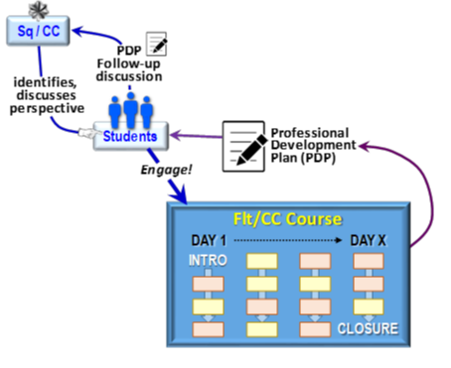
Course Phases
Phase 1: Pre-Course
Phase 3: Post-Course
Phase 2: In-Course
Notes:
(02:10-05:00)
The FCLC model breaks a course down into three phases: pre-course, in-course, and post-course.
Phase 1: Pre-Course
(CLICK for ANIMATION) The pre-course phase happens 1-2 weeks before the course begins. Pre-course activities prepare the participant for success in the classroom. Activities include a discussion with the squadron commander (or equivalent) which is important for expectations and goal setting, and any pre-readings which the course director selects for awareness.
Phase 2: In-Course
(CLICK for ANIMATION) Phase 2 is the actual course itself. During the course, participants engage in selected leadership lessons (which are AU-provided) and local content lessons (provided by base experts or agencies) over the course of several days.
In the AU-provided leadership lessons, participants review materials (like videos and handouts), engage in conversation, complete exercises, and assess themselves on flight-level leadership behaviors critical to success.
In locally-provided lessons, participants receive important information about base agencies and programs, and gain perspectives from local leadership.
These in-course lessons culminate in an end-of-course assignment: the creation of a Professional Development Plan (PDP) to guide future development.
Phase 3: Post-Course
(CLICK for ANIMATION) Phase 3 is perhaps the most important – as the in-course lessons are, in themselves, only the beginning of learning.
After the course is complete, participants write a Professional Development Plan which provides a roadmap for their future development. This plan is briefed to the participant’s squadron commander (or equivalent) to garner feedback and developmental support, and to earn course credit.
When you put all three of these phases together, you get not a course…but a development experience which introduces, reinforces, and sets the students up to master the leadership skills necessary for success in their job.

Slide 26
Course Flow
Phase 1: Pre-Course
Phase 2: In-Course
The Road Ahead Lesson
Commander Interview
Role of the Flight Commander Lesson
Phase 3: Post-Course
Professional Development Plan
Commander Outbrief
Notes:
(05:00-06:45)
Mastery comes through the use of the Professional Development Plan in Phase 3. Courses that choose not to include the PDP risk voiding the entire FCE approach to leadership development.
Why? Because you can only learn so much in a classroom.
Our three-phase model drives individual leadership growth through self-reflection and assessment. This self-reflection and assessment starts before the course with the Commander Interview. In this interview, participants (many for the first time) get to learn the commander’s perspective on leadership, discuss specific real-world goals for the participant’s flight, and establish desired outcomes – or things the student should learn from the course AND BE ABLE TO DO in the real world.
We recommend that each FCE course start with a specific AU-provided lesson -- The Role of the Flight Commander. This lesson leverages the pre-course commander discussion (from Phase 1) and sets the stage for self-assessment at the end of each leadership lesson in the classroom.
We also recommend that the course close with another AU-provided lesson -- The Road Ahead -- where participants are given instructions to draft their own PDP and close the loop with their squadron commanders through a post-course discussion (in Phase 3).
This Professional Development Plan is critical to success. (this is the bridge to the next slide)

Slide 27
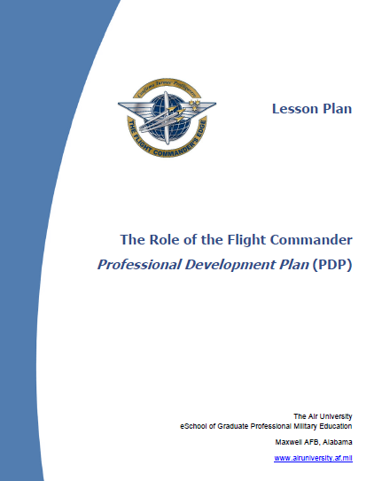
The Professional Development Plan: Critical to Success
Capstone Exercise
Reinforces behavior
Improves performance
Commander Involvement is Critical
Notes:
(06:45-07:45)
The PDP is a key component of the experiential learning approach used throughout the course. Without this practical exercise as a capstone, behaviors may not be adequately reinforced and result in improved performance.
The pre- and post-engagement with the squadron commander:
is critical for preparing the participant for the course;
solidifies their understanding of the roles they play within the organization, and
Charts a course for further development as a leader.
The PDP is critical to close-the-loop in learning – learning which starts with the pre-course commander discussion, and ends with certificate presentation by the squadron commander after the PDP-based discussion.
In between comes all the "experiential" lesson goodness – and Mike's going to talk about that right now.

Slide 28
Workshop Part III
Experiential Learning: Learning by Doing
or, “How do Lessons work?”
Notes:
(00:00 – 00:40) (MIKE)
Thanks KV.
By now, you are probably wondering – how do lessons work? We've said that you don't need to be an expert to put on one of these courses in your unit...and you are probably wondering how that is possible.
The answer is what we call "experiential learning" or "learning by doing."
Our leadership lessons are the exact opposite of what most of you have grown to expect – Death by PowerPoint. And we've written them so that anybody can teach them...even someone without a background in leadership.
But I'm getting a little ahead of myself. Let's take a look at how lessons fit into the overall course picture first.

Slide 29
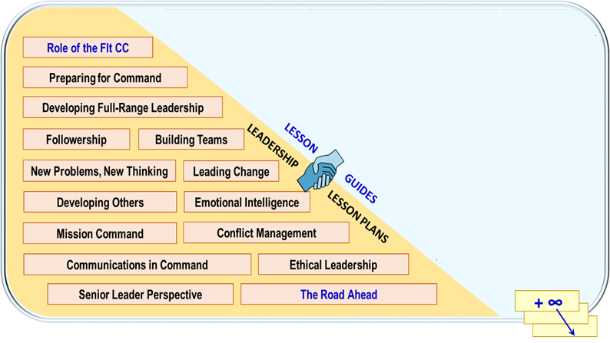
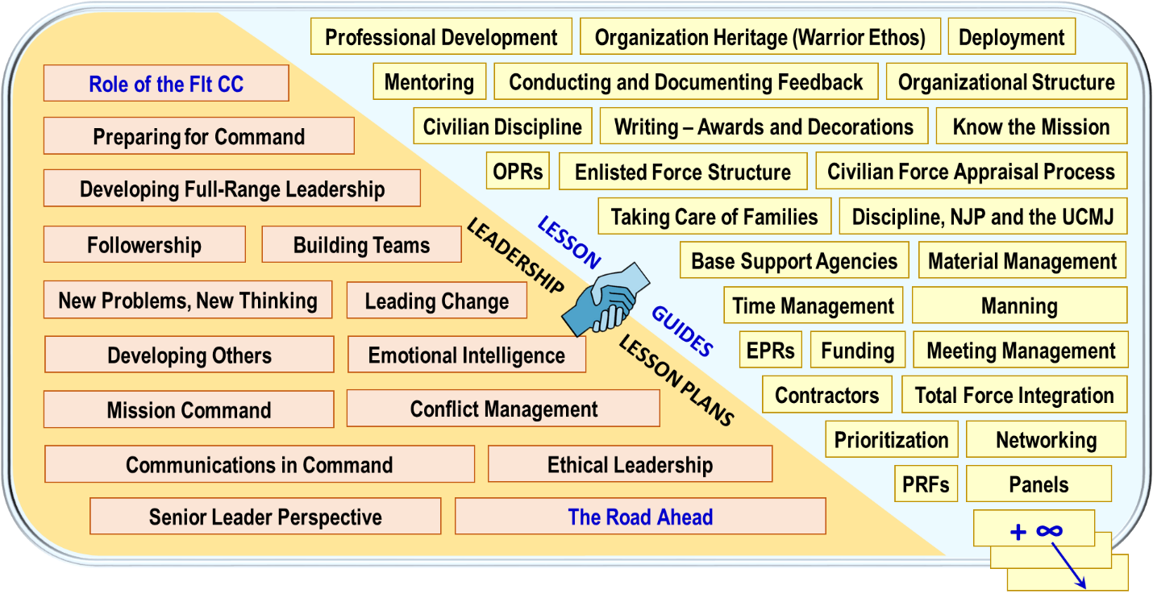
Lesson Plans
Notes:
(00:40 –02:00)
The content for a Flight Commander Leadership Course comes in two forms: Lesson plans and lesson guides.
Let's take a look at the lesson plans first.
(Click)
Air University provides recommended leadership lesson plans through The Flight Commander’s Edge community. That is what you see here on the left side of the screen. We have a TON of topics already prepared which reflect the things that all flight-level leaders need to be good at from a leadership perspective.
Things like: preparing for flight command, full range leadership, biulding teams, solving problems, and others.
All of these AU-provided lessons are “ready-to-use,” meaning they include everything you need to use to execute them. Slides, handouts, even a script so that you don’t need to be an expert to present them.
These lessons were built by the leadership experts at The Flight Commander's Edge based on the input of leaders (both senior and junior) all around the Air Force. They are universal – and apply to flight level leaders everywhere. In fact, if you look closely they reflect the core leadership concepts reflected in both the new Airman's Foundational Competency Model AND the even newer Airman Leadership Qualities.
In other words – if you are a flight level leader, these are the things you must know to not suck.

Slide 30
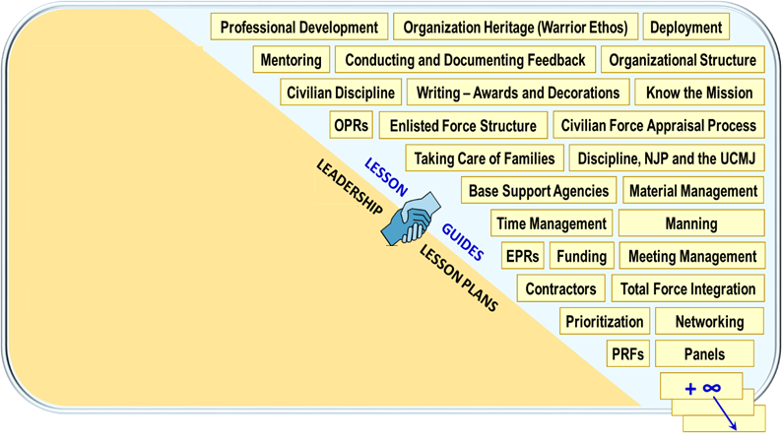
Lesson Guides
Notes:
(02:00- 03:08)
On the other side of the screen are our Lesson Guides.
(Click again)
Lesson Guides are NOT full lesson plans. They are exactly what the name implies – guides for you to provide to YOUR LOCAL BASE EXPERTS. They don’t provide lesson content themselves. Instead, they serve to help your LOCAL BASE EXPERTS – people like the JAG, or someone from Manpower, or someone from Services -- tailor presentations to things that flight-level leaders need to know.
For example, if your commander wants to include a lesson on Discipline, Non-Judicial Punishment, and the Uniform Code of Military Justice, you will ask the JAG to develop a presentation for you. The lesson guide will help your Staff Judge Advocate tailor something specific to the right level for the course and the audience.
These guides are just ideas for you to include in your courses. Your commander may want to include other topics not listed here. That's perfectly ok. In fact, it is highly encouraged. Some of you may already have recommended lesson topics from your commanders that don't have a guide. Let us know. Help us write one that we can share with others across the force through our community.
Before we move on from lessons, there are a few special ones we need to talk about.

Slide 31
Special Lessons
Notes:
(03:08 – 4:30)
Of the 15 AU-provided lessons, we have four CORE lessons that we recommend ALL courses use.
(click again)
We’ve already discussed two of these:
The Role of the Flight Commander is meant to be the first lesson in every course. It sets the stage for success when combined with the pre-course commander interview.
The Road Ahead lesson is the last lesson of the course. It paves the road ahead for completion of the Personal Development Plan and sets the stage for mastery of course outcomes.
Together, these two lessons – first and last – are known as the BOOKEND lessons. No course really would be complete without them.
The other two CORE lessons are Preparing for Command and Senior Leader Perspective.
(Click)
Preparing for Command highlights the responsibilities of flight level leaders and how to prepare for those responsibilities.
Senior Leader Perspective presents a high-level leadership perspective on what is important at the flight-leadership level and how flight-level leaders are critical to the mission.
We think every flight-level leadership course should contain these four lessons, because they are the ones that truly set the stage for flight-level leadership success.

Slide 32
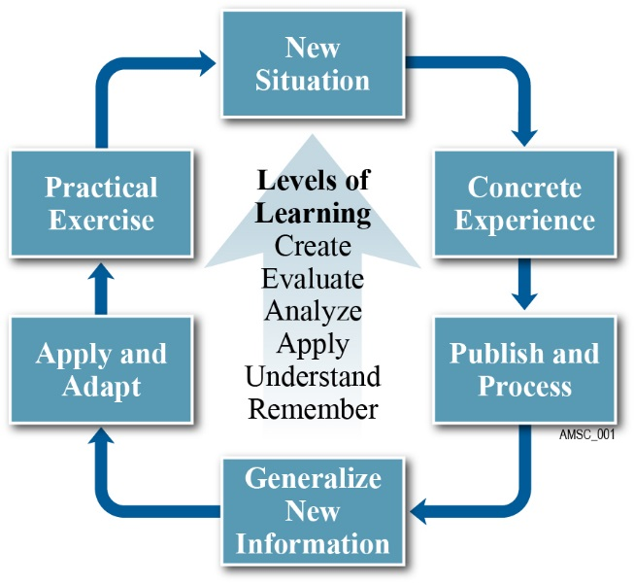
The Experiential Learning Model
Notes:
(04:23-05:15)
Ok, so how do our lesson plans work?
The key to all our lesson plans – the reason that anybody can teach them -- is because they are written using a really cool approach called the "Experiential Learning Model."
We aren’t going to talk about the theory behind this model, but you need to know how it works. (If you want to learn more, there is a lot of detail in your workbook and the Course Director Handbook.)
Experiential learning is "learning by doing." It is based on the key idea that we learn best from "direct experience" -- and the more times we are exposed to a subject, and the more times we interact with it in a meaningful way -- we get better. We move up the levels of learning ladder from simply understanding something, but instead being able to do or create something based on that new knowledge.
All of that is shown on the chart here. Lots of words, but would you believe you've been doing it already today?

Slide 33
The Experiential Learning Model
Notes:
(05:15 – 05:35)
Before this course, none of you knew anything about building a flight level leadership course. You were faced with a "new situation."
You enrolled in our course, and expected just to show up at the workshop and have knowledge poured into your heads, right?
That's traditional, or classroom style learning. Not experiential learning.

Slide 34
The Experiential Learning Model
Watch a Video
Conduct Interview
Take Poll
Register for Website
Notes:
(05:35 – 06:00)
You may have been surprised when we sent you pre-course homework -- just like when you were back in grade school or university.
In this homework, we asked you to do some things to prepare for class. Watch a video. Conduct an interview. Take a poll. Register for a website.
By doing this, all of you were given the same background before the course started -- you all had the same concrete experience upon which we could build.

Slide 35
The Experiential Learning Model
Discuss Experience
Share Knowledge
Prep for Class
Notes:
(06:00 - 06:40)
Today, in the workshop, the first thing we did was talk about what you discovered during your interviews. In a short breakout session, you presented -- or published -- your "results" to others, and you had an opportunity to hear what others had to say and think about – or process – how their results may have been different from yours.
In this session, if you didn't come prepared for class by doing the prework, you also had the opportunity to get smart on the question and begin thinking about your own answers – so that you wouldn't be completely lost as we moved on with the rest of the workshop. (Pretty slick, huh?)

Slide 36
The Experiential Learning Model
Learn New Things →
← Small Chunks of Info
Notes:
(06:40 – 08:15)
After you had a chance to get yourself situated with the pre-work by talking about it in your breakout groups – by the way, that was the second time you were presented with some of the course key concepts – we started a series of mini-lectures about The Flight Commander's Edge program. Small chunks of new information -- all tied together -- so that you can generalize how everything in the FCE program works.
Courtney talked about the purpose of the program.
KV talked about the structure of the program.
Now, I'm talking about how our lessons work.
Through these mini-presentations, we are giving you new information in chunks – and giving you an opportunity to do something with it through the note-takers in your workbook -- so that you are not overwhelmed.

Slide 37
The Experiential Learning Model
Practice
Use information
in new ways
Notes:
We do that, so that you are ready to -- in the next segment – adapt the new information we've taught you and apply it to your own situation. Then, you can exercise that knowledge in a practical situation -- in this case back at your own unit when you conduct your own course.
And that’s it. By following the experiential model, we build on little bits of knowledge – each reinforced over and over -- to get you to achieve the final goal: Your own practical course.
Personally, I think it is a pretty slick way to learn. And it is the way all of our lessons are built in the course so that you don't need to be an expert to teach them.

Slide 38
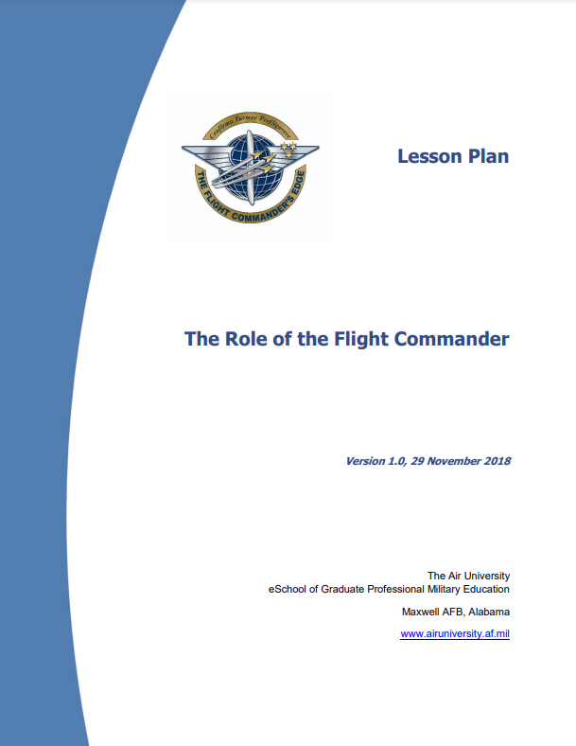
How does it work in practice? Let’s look at a lesson….
Workbook
Page 16
Notes:
(0815-11:00)
So, how does it work in practice?
Turn in your workbooks to page 16. There, you will see the first page of The Role of the Flight Commander Lesson.
We will walk through the first few pages so that you get an idea of how this all works.

Slide 39
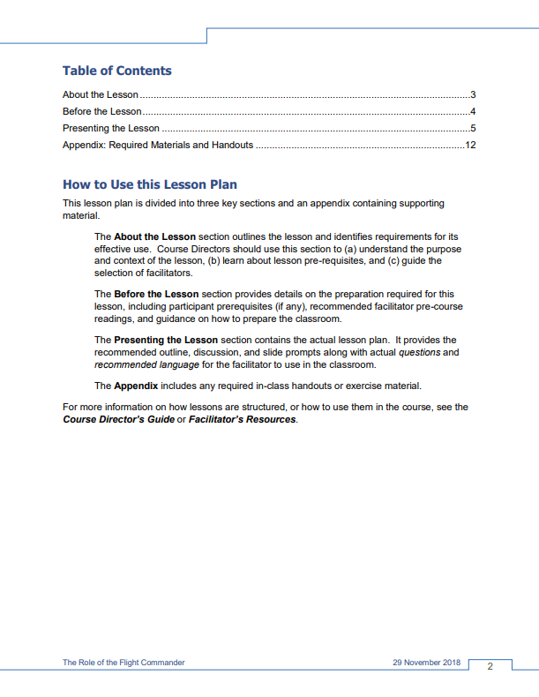
How does it work in practice? Let’s look at a lesson….
How to use the lesson
About the lesson
Before the Lesson
Presenting the Lesson
Appendix
Notes:
Let’s start on page 17, that is the second page of the lesson plan.
(Note – I don’t expect you to read what is on the screen. In fact, I intentionally made it unreadable just so that you would need to follow along in the real lesson plan in your workbooks…to get the full experience for how things work – that’s a key idea for what we just talked about in Experiential Learning.)
Here, we tell you how to use the lesson plan. Every lesson is the same, so if you understand how to use one lesson plan, you will understand how to use all lesson plans.
It even reminds you that you can always look for more information in the Course Director’s Guide, or the Facilitator Resources in The Flight Commander’s Edge community.

Slide 40
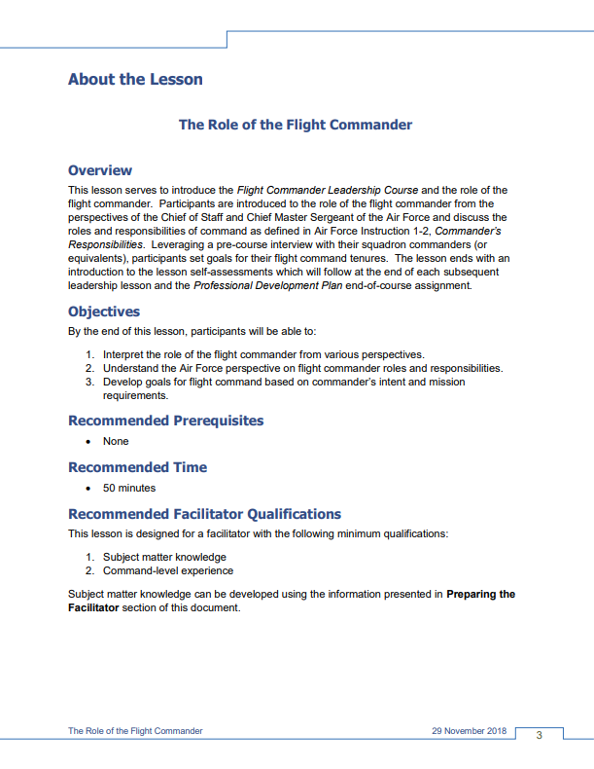
How does it work in practice? Let’s look at a lesson….
About the Lesson
Overview
Objectives
Prerequisites (if any)
Time Requirements
Facilitator Requirements
Notes:
The next page, page 3 in the lesson plan, gives you all the info you need about the lesson. A brief overview. The lesson objectives. How long it will take. And a recommendation on who should present it.
In this case, it is recommended that someone who has been a commander in the past present this lesson.

Slide 41
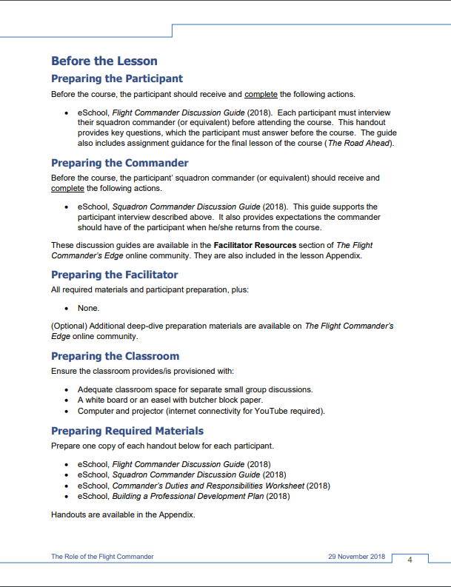
How does it work in practice? Let’s look at a lesson….
Before the Lesson -- PREPARING
Participants
Commanders
Facilitators
Classroom
Required Materials
Notes:
Page 4 of the lesson plan talks about preparing to conduct the lesson:
What your participants – or students -- must do to prepare.
What, in this case, the squadron commander of your participants must know and do to prepare.
What your facilitator must do to prepare to teach.
And what you, as the Course Director must do to prepare the classroom and prepare the materials.
Think of this as a checklist for executing this specific lesson. Just follow the checklist and you are good to go.
Oh, also, every handout or guide required here is included in the appendix, so you can just print them out and use them. You don’t need to go looking for other documents in other places – it’s all right here.

Slide 42
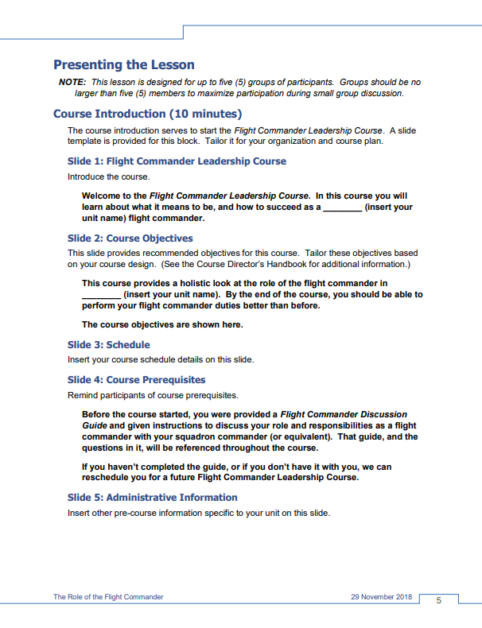
How does it work in practice? Let’s look at a lesson….
Presenting the Lesson
Step-by-Step
Queued to Slides
Text to Read (if desired)
Notes:
(xx:00 – 11:41)
Page 5 of the lesson plan begins the classroom lesson itself. It walks you through the slides one by one and tells you exactly what to say. Your facilitator can simply read it, or tailor the words to their own presentation style.
In fact, if you flip to the section that says Slide 9 which I’ve highlighted here, you will see it even walks you through the exact things to say and do in small group sessions. And then after those sessions, the lesson tells you how to discuss – or publish and process -- the results. This goes on throughout the rest of the lesson plan, all the way up to the end.
Every lesson plan is like this. It walks you through – step by step – slide by slide – to get your class participants learning experientially.
It works, and it works really well. But you know, it would probably be easier if you saw it in action.
So, here is what we are going to do... we are nearly at the one-hour mark. We are going to take a 10-minute break so you can take care of business, but during that break we are going to roll some segments of a video shot just for this lesson. It is of a facilitator – someone who was simply given a lesson plan and asked to execute it in the classroom, with only a little bit of preparation.
During the break – glance at the video; flip thru the rest of the lesson plan in the workbook. See how easy it is to execute one of the AU-provided lesson plans. And then, when we come back, we will adapt and apply what we've learned so you can design your own flight level leadership course.

Slide 43
Break
Please Return in 10 Minutes
https://www.youtube.com/watch?v=Qbk0BmCat58&t=406s
Notes:
Post video link in chat as well.
https://youtu.be/Qbk0BmCat58?t=406

Slide 44
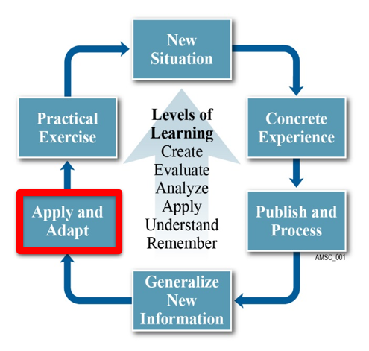
Workshop Part IV
Designing a Flight Commander Leadership Course
Notes:
(00:00- (MIKE)
So, welcome back.
Before the break, KV presented the “big picture” of The Flight Commanders Edge to you –
starting with Commander’s Intent, through development of a customized Flight Commander Leadership Course designed specifically for your unit’s needs, to closing the loop with the post-program leadership development plan and commander’s followup.
Now we are ready to begin building, so in this part, the “rubber will meet the road” so to speak.
Over the next 30-to-45 minutes, we will do the four steps needed for applying The Flight Commander’s Edge methodology to your own situation, and adapt it to create your own Flight Commander Leadership Course.
Ready? Lets get started.

Slide 45
The Plan for Part IV
Breakout Session
25-30 minutes
“Do the steps” to design your own course
Expert help available via facilitator
Overview of Steps
Understanding Needs and Constraints
Identifying Your Lessons
Selecting a Template
Building a Schedule
Return and Out brief
Notes:
So, here is the plan.
Over the next five minutes or so, I will present a very brief overview of the four steps needed to build your own courses.
These steps are spelled out in detail in your workbook, so you can follow along.
Then, we will transition to our second breakout session. This session will, depending on how much time we have left before the end of the workshop, last about 25-30 minutes. In it, you will do the steps needed to design your own course – using your workbook as a guide. Your facilitator will be there to help.
Then we will return and have a quick out-brief – in fact a few of you will be given the opportunity to share the design and layout of your course so others may get some idea
The goal: In the end you will have your own schedule, ready to execute. And we will give you tips to execute that schedule in our final section before we close out.

Slide 46
The Plan for Part IV
Breakout Session
25-30 minutes
“Do the steps” to design your own course
Expert help available via facilitator
Overview of Steps
Understanding Needs and Constraints
Identifying Your Lessons
Selecting a Template
Building a Schedule
Return and Outbrief
Notes:
Ok, so let’s talk about designing your own course.
There are four distinct steps – shown here on this slide.
Each one has a corresponding worksheet or informational section in your workbook. Right now, turn to the section titled “Understanding Needs and Constraints.”

Slide 47
Step 1: Understanding Your Needs and Constraints
What must my workshop cover?
How long must my workshop be?
Who is my target audience?
Will my commander participate?
What other key things must I DO or NOT do with this workshop?
Notes:
Up until this point, we’ve been talking about your units needs in terms of commander’s intent – essentially what your commander wants you to do.
Its time to translate those into needs and constraints – or Must Dos and Must Not Dos.
On page 7 of your workbook, in the first breakout session, you discussed what your course should include – from the perspective of your commander and the other members of your group. You will use that information here, along with other nuggets to complete the worksheet on page 28.
Fill in the blocks to answer the questions provided:
What must my workshop cover? In other words, what are the ABSOLUTE must-have lessons in my course – the ones my commander wants?
How long will my workshop be?
Who is my target audience?
Will my commander participate?
What other key things must I DO or NOT DO with this workshop?
Record your answers on your worksheet, and move to step 2. Since we’ve been talking about these needs and constraints since the beginning of the workshop, this should be a very quick exercise.

Slide 48
Step 2: Identifying Your Lessons
Select your lessons​
TIP 1: Review the lesson synopses on pages 30-34 in your Workbook.​
TIP 2: More detailed info on each lesson is available at:​
https://tinyurl.com/FCEDescriptions
and in the community.
Notes:
Step 2 is to identify your lessons. To help you do this, we’ve provided the worksheet on page x which lists all of the AU-provided lesson plans AND the suggested lesson guides AND we also give you space to write your own lesson titles in case you have something you need to address that is not pre-prepared.
Review the lesson plan and lesson guide synopses provided on pages 30-34 to learn more about the topics covered in each lesson.
Simply check off the lessons here as you decide which ones you want to include.
Here is an important tip – every FCE lesson is planned for a one hour block. So if you have a TWO day course, you need to choose 14-16 lessons.
Once you figure out the lessons you want to include, move on to step 3.

Slide 49
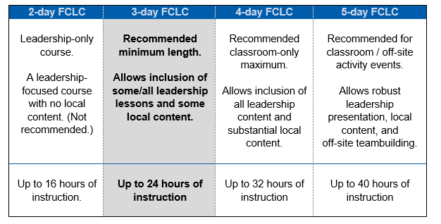
Step 3: Selecting a Template
Notes:
Once you have your course length and lessons, it is simply time to select a template.
To make that easier on you, we provide four course templates which you can plug your lessons into. You don’t have to use these templates, but many units do just for simplicity.
This chart, and some additional information on selecting a schedule template is provided in your workbook on page 35.
(pause)
The 2-day FCLC is a leadership-only course, built using only the AU-provided leadership lessons. Now this isn’t recommended because this course doesn’t address any local content. It’s available if you only have a short period of time to work with.
The 3-day FCLC is a leadership and local content course. It is the most common course structure used in the field.
The 4- and 5-day courses are for longer courses designed to cover a lot of local content, often with a lot of leadership involvement. We’ve even seen these longer courses have activities like paintball, barbeques, and other team-building events.
The sky is the limit – you can include whatever is NEEDED to meet your unit’s specific needs for leadership development.

Slide 50
Step 4: Building a Schedule
Populate your selected template
TIP: Use BOOKEND lessons
The Role of the Flight Commander (first)
The Way Ahead (last)
TIP: Use key lessons for context
Preparing for Command
Senior Leader Perspective
Notes:
The final step is to actually populate your template.
Once you have decided the format you want to follow, simply plug in your lessons in whatever logical order you choose.
However, remember a few key things we recommend:
The first lesson should be “The Role of the Flight Commander” and the last lesson should be “The Road Ahead.” Together, these bookend lessons set the stage for pre-course learning and post-course follow-up … both of which are CRITICAL to the experiential learning method used in our courseware.
We also suggest that you include “Preparing for Command” and “Senior Leader Perspective.”
Preparing for Command is a lesson that should come close to the front. It helps future flight level leaders identify key things that they SHOULD or MUST do before taking over a leadership role.
Senior Leader Perspective can come anywhere in a course. We’ve seen commanders come in right at the front and set the stage, and expectations for learning. We’ve also seen commanders come in near the end to provide a wrap-up and motivation to succeed. It’s up to you. The lesson plan for this provides a lot of options, and recommendations, for your commander to follow.
Other than these recommendations, you can structure your course however you want. Have fun. Be creative. Figure out a model that meets the needs of your unit and addresses your commander’s expectations.
All four course templates are included in your workbook – so at this step, you will work with your facilitator to select and fill one in to complete your course design.

Slide 51
Breakout Exercise
Breakout Group Slide IV-1
Given:
Your interview results
Knowledge from this presentation
Worksheets Workbook
Design your own Flight Commander Leadership Course
Two lucky participants will be asked to share their course agendas (if we have time) in the follow-on session
25 Minutes
Notes:
(--- - 06:57) And that brings us to our second breakout group.
In this longer breakout session, you will take your interview results, what we’ve talked about so far, and the worksheets in your workbook and design your own course.
Your facilitators will be there to help you along, so don’t hesitate to ask questions of them and of each other.
Come up on camera and don’t hesitate to share information and get each others help.
We will do this for about 25 minutes and then return to the large group, where we will ask a few of you – time permitting – to tell us about the course you’ve developed.

Slide 52
Go to Breakout Groups
Return here in 25 minutes…

Slide 53
Your Task
Breakout Group Slide IV-1
Given:
Your interview results
Knowledge from this presentation
The FCE Course Director Workbook
Design your own Flight Commander Leadership Course
25 Minutes
Notes:
Note to Facilitators:
This needs to be a very fast group. There is a lot to cover in a very short time. Not all students will complete the exercise. Encourage, don’t push.
Kick off by asking if there are any questions on the instructions, then get the students right into the workbook. Note that students don’t need to use the workbook, but it is there to provide some structure. The ultimate goal is a completed course agenda.
You will probably field a lot of questions on the entire process here. That is expected.
After about 15-20 minutes, assess whether any of the students have a product that they would like to talk about (or even show by sharing desktop) to the larger group. We want to have 2 or 3 of these to show (depending on time).
If a student is completely lost, refer to the sample schedules on the slides attached. Don’t share these unless you absolutely need to – we don’t want all answers looking the same.

Slide 54
Other Instructions
Follow the worksheets in your workbook.
Step 1: Understand Needs and Constraints
Step 2: Identify Your Lessons
Step 3: Select a Template
Step 4: Build a Schedule
Specific group instructions (from facilitator)

Slide 55
Return from Breakout Groups
Picking up where we left off…

Slide 56
What did you create?
Volunteers? (Two presenters – if time permits)
Tell us:
Where you are from
The length of your full course
The three most important lessons…and why you chose them
or
What is different about your course?
Notes:
(MIKE)
Welcome back!
So, I hope that was a rewarding experience.
Let me ask our facilitators – do you have anyone who would be willing to share his or her course schedule?
You don’t have to come up on camera or share documents, but you can if you want to. What we would ask is that you take a minute or two and tell us: where you are from, how long your course is, and the most important lessons and why you chose them (or why you chose to do something different with your course).

Slide 57
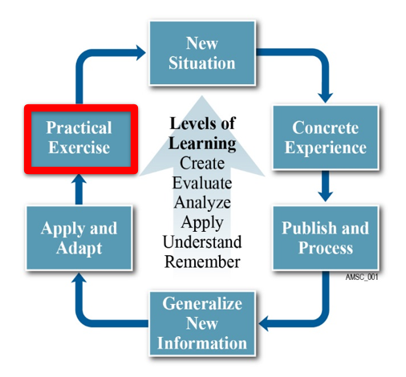
Workshop Part V
Preparing a Flight Commander Leadership Course for Execution in the Real World
Notes:
(00:00 – 00:10) (COURTNEY)
Ok, that brings us to Part five– very near the end of the workshop.
You now have a schedule for your course, but how do you prepare it for teaching it in the real world?

Slide 58
Preparing to Teach Your Own Course
Scheduling your course
Selecting and preparing leadership lesson facilitators
Selecting and preparing locally-produced content presenters
Preparing your squadron commanders (or equivalents)
Preparing your participants
Preparing the classroom
Notes:
(00:10 – 01:15)
Believe it or not, the hardest part of putting a course together is getting agreement on what to cover –
that is what the FCE methodology is designed to walk you through quickly.
After that, all you need to do is execute. And execution is a matter for checklists.
The steps to actually make a course happen are pretty straightforward.
In fact, they are so straightforward that we’ve reduced them to some simple checklists in your workbook.
Starting on page 42, you will find six checklists with tips in very important areas:
scheduling your course
selecting and preparing leadership lesson facilitators
selecting and preparing locally-produced content presenters
preparing your squadron commanders (or equivalents)
preparing your participants, AND
preparing the classroom
On these checklists, we have provided steps for what we think you should do to ready your course for presentation.
When you get back to work after this workshop…talk to your commander to get approval for your schedule, break out these checklists, and get teaching. It will be easier than you think.
And with that, I will turn it back over to KV to discuss a very important part of the workshop – where to get help!

Slide 59
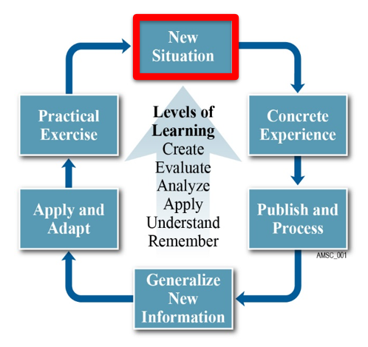
What’s Next?
Where Can I get Help?
Q&A
Notes:
(00:00 – 00:25)
Thanks Courtney.
So, what’s next?
Well, you are now back in a “new situation.” It is time to go and execute your own course.
Where can you turn for help?
You can turn to US. Always remember that professional help from the FCE team at Air University is only just an email or chat in the community away.

Slide 60
Notes:
(00:25 – 01:30)
The Flight Commander’s Edge community is a Community of Practice filled with lots of great people who share a concern or a passion for developing leaders. It is incredibly important to the success of the FCE program, and it is the key source of content and help for you as you move forward.
The Flight Commander’s Edge online community provides a mechanism for the eSchool to distribute course content and supporting materials, and for you – the course directors -- to communicate, collaborate, and share. What can you share? Courseware, best practices, lessons learned, and feedback. And those course schedules you created! And you can ask questions, too.
Your participation in the community is critical to the success of the FCLC program.
By signing up for this webinar you have been given information on how to gain access to the FCE community.
To gain access, contact the eSchool. Contact information is on page 3 of this document.

Slide 61
What’s Available in the Community?
The Role of the Flight Commander (intro lesson)
Preparing for Command
Emotional Intelligence
Followership
New Problems, New Thinking
Developing Full-Range Leadership
Communication in Command
Mission Command in Leadership
Building Teams
Leading Change
Developing Others
Conflict Management
Ethical Leadership
Senior Leader Perspective
The Road Ahead (closing lesson)
The Intellectual and Leadership-Development Center of the Air Force
Notes:
(01:30 – 03:15)
So, what is available in the community?
From the homepage on AU Canvas, you can access all FCE handbooks, lesson plans, lesson guides, and supporting materials such as slides and other useful products.
The Getting Started section provides an introduction to the community and how to use community resources to build your local course.
The Course Template section provides sample course templates and a place where units can upload and share their course timelines, as well as a Lesson Descriptions resource that can be referenced while building a course.
The Facilitator Resources section provides a guidance on lesson facilitation and other useful lesson presentation tools, as well as a discussion board where facilitators and presenters can discuss tactics, techniques, and procedures for successful classroom engagements.
The Lesson Materials sections provide leadership lesson plans and lesson guides for recommended topics. Facilitators can ask questions here on specific topics, or upload materials they have produced to use in the classroom. The area changes based on the community input so check back frequently.
Bottom line, you aren’t alone…

Slide 62
Help Us Grow!
The Role of the Flight Commander (intro lesson)
Preparing for Command
Emotional Intelligence
Followership
New Problems, New Thinking
Developing Full-Range Leadership
Communication in Command
Mission Command in Leadership
Building Teams
Leading Change
Developing Others
Conflict Management
Ethical Leadership
Senior Leader Perspective
The Road Ahead (closing lesson)
The Intellectual and Leadership-Development Center of the Air Force
Notes:
(03:15 – 3:47)
…and you can help us grow.
As you build your courses, PLEASE give us feedback on the process and on our lesson plans. Also, PLEASE submit your own lessons – including schedules, slides, videos, anything you use to teach – so that it can be used to help others in the FCE community.
You can do that by clicking one of the feedback or upload links right in the community.
I’m going to go ahead and hand this back over to Courtney.

Slide 63
Q&A
So, what ‘ya got?
Notes:
(Courtney) And that brings us to the end of the presentation.
The rest of the time today is dedicated to Q&A, then we will do a quick wrap-up at the end.
So, if you have a question that you would like to ask, just raise your hand or type it into the chat.

Slide 64
So… Close…To…Conclusion, almost
Can you….
Describe why CCs are critical to flight-level leadership development?
Explain how FCE enables leadership development?
Describe the Flight Commander Leadership Course design framework?
Appreciate how the Experiential Learning Model enables informal learning?
Apply/adapt AU-provided materials to design your own FCLC?
Prepare your own FCLC for execution?
Notes:
So, folks, that’s it. We’ve enjoyed presenting the workshop for you today. Hopefully you feel like it has been worth your time.
When we started, we had a few short goals in mind.
Only you can determine whether we’ve been successful in achieving them;
however, we are confident that the experiential method employed today will get you off on the right foot toward preparing your own flight commander leadership course for execution.
One final thing before we go,

Slide 65
Special Thanks
Mrs. Carolyn Knutson-Vaccaro
Mr. Mike Hower
Dr. Chris Shannon
Dr. Stephanie Hostetter
Maj Travis Neal, DSL
Maj Adam Bartczak
Notes:
I’d like to thank some folks on my team without whom this wouldn’t have been possible.
First, KV – our lead facilitator and lesson plan author.
Mike Hower – our spirit guide for all things associated with experiential learning.
And an extra special set of thanks to Dr. Chris Shannon, Dr. Stephanie Hostetter, Majors Travis Neal and Adam Bartczak for both supporting the program from its inception and facilitating our breakout groups today. Without your help, none of this would have been possible.

Slide 66
The end
Notes:
Thanks for attending today.
We will keep the room open for as long as anybody wants to stick around and ask questions.
Once again, thank you…and we look forward to seeing you in the community.

Slide 67
Flight Commander Architecture
“Flight commander/leader courses [will]
focus on key skills needed to succeed
in this first essential level
of leadership.”
– SecAF/CSAF,
1 Jun 18
“A graduate of the Flight Commander Course should
be equipped and motivated to strengthen
their squadron by leading,
developing, managing, and
communicating with
competence and
confidence.”
– Program Vision
Statement
NAFS
Wg / CC
MAJCOMS
The Flt/CC Community
Collaboration
Best Practices
Lessons learned
expectations,
perspective
Sq / CC
identifies
wing CD
PDP
Follow-up
discussion
develops, maintains
identifies,
discusses
perspective
provides
lesson guides,
curates
eSchool
Students
Professional
Development
Plan (PDP)
Lesson Vault
provides
support
Engage!
Organizational Structure
Org Heritage
Facilitator(s)
conducts
course
Role of the Flt/CC
provides
CD handbook,
templates
Flt/CC Course Template
Total Force Integration
Funding
Full-Range Leadership
Taking Care of Families
OPRs
DAY 1
DAY X
Preparing for Command
identifies
INTRO
LOCAL GUIDES
Discipline / NJP / UCMJ
New Problems, New Thinking
LEADERSHIP LESSONS
Leadership Panels
selects content
builds course
Followership
Emotional Intelligence
Course
Director
Deployment
Developing Others
Sr Ldr Perspective
+ ∞
CLOSURE
Communications in Command
Leading Change
Mission Command
Building Teams
The Road Ahead
Notes:
Thanks for attending today.
We will keep the room open for as long as anybody wants to stick around and ask questions.
Once again, thank you…and we look forward to seeing you in the community.

