Slide 1
LPC-21 Thursday 25 March
Notes:
Greetings all and welcome to our final day of the 2021 Learning Professionals Consortium
Hope you have enjoyed the event thus far. Lieutenant General Webb inspired us in the keynote with some great highlights of how what we do as LPs impacts the DAF by Developing the Airmen We Need.
We have heard speakers from AFWERX, AFIT, AFAMS, and AFMC. Furthermore, we enjoyed presentations from USAFA, the 81st Training Support Squadron, and the US Army Research Institute for Behavioral and Social Sciences.
We are excited to have had such great participation. There were over 600 registered participants from around the world, inside and outside the DAF.
We are also thrilled to have the opportunity to bring this event to you virtually. It opens worlds of possibilities and amplifies the value of the effort our presenters and staff put into bringing the content to you.
We want to take this opportunity to thank our partners National Conference Services Inc or NCSI. They have been invaluable to our AETC team in enabling our virtual event. Also, they have proven their merit in adapting to fluctuating circumstances. SLIDE

Slide 2
Thursday 25 March
TIME | SESSION
0800 - 0900 | Login to the Virtual Event, Online Exhibit Hall Opens
0900 - 0930 | Opening Remarks - Dr. Angi Canada, Division Chief, FD Credentialing
0930 - 1000 | Keynote Speaker – Dr. Bonnie Houser, Deputy Chief, Air Force Voluntary Education
1000 - 1100 | Industry Presentations: Each Exhibitor has 5 Minutes
1100 - 1115 | BREAK
1115 - 1145 | Learner-centered Teaching and Learning - Davina Farrell, ESL/EFL Specialist
1145 - 1215 | Innovative Counseling Approaches - Ms. Audrey Herwig Mendoza, Faculty Development Training Development Chief
1215 - 1300 | LUNCH BREAK / OPEN NETWORKING
1300 - 1330 | Teaching Strategies that Lead to Deeper Learning - Dr. Shelley Howell, Interim Associate Vice Provost for Teaching and Learning Services
1330 - 1430 | Industry Presentations: Each Exhibitor has 5 Minutes
1430 - 1445 | BREAK
1445 - 1515 | Flipping Avionics Training Upside Down - TSgt Shannon van Roekel, Career Development Manager, 365th Training Squadron
1515 - 1545 | 2020 AETC Learning Professional Training Gap Analysis - Dr. Randy Coats, Deputy, AETC/A9
1545 - 1615 | Anytime Learning Anywhere Device Info Net (ALADIN) - Juan C. Cobar, Instructor Supervisor
1615 | Event Wrap Up and Way Forward – Ms. Dana Horn, Chief, AETC/A3BP Learning Professionals Branch
Notes:
Today we have another great day planned for you including speakers from the University of Texas at San Antonio, the 37th Training Support Squadron, the 365th Training Squadron and, our featured speaker for today, Dr. Bonnie Houser, who I will introduce in a few minutes.
Take advantage of tuning into to our Industry Partners whose participation enable us to bring you this virtual event. They have two time periods available, 1000-1100 this morning and 1330-1430 this afternoon.
Now I would like to tell you a bit about what the Force Development Credentialing Division is doing to enable Airmen to plan their career paths and communicate to leadership all they know and can do. SLIDE

Slide 3
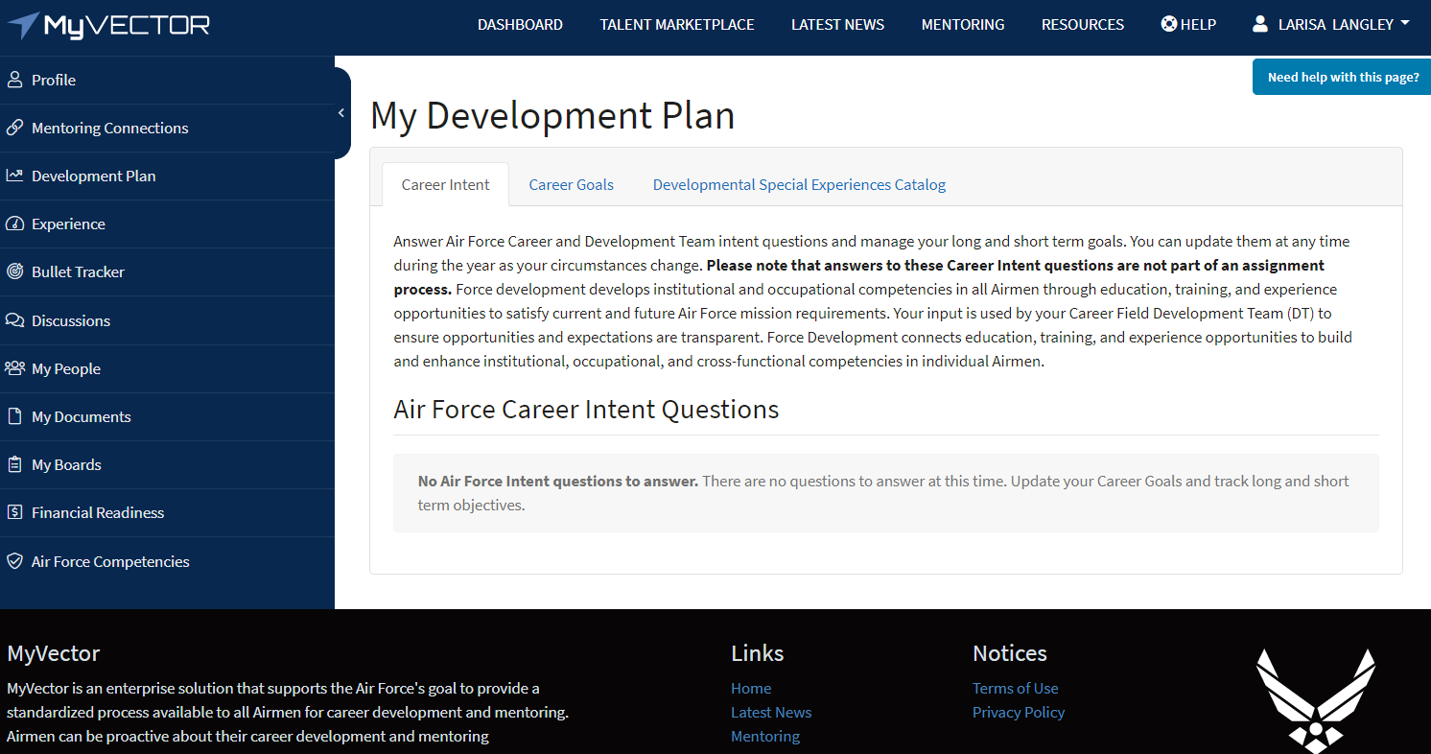
A3B FD Mission - DSEs
Notes:
During 2018 CORONA, the Secretary of the Air Force and Chief of Staff of the Air Force established a Force Development (FD) Commander who is charged (among other things) with executing the long-range strategic development of Total Force Airmen (Guard, Reserve, Regular Air Force and civilian) through a deliberate process that combines education, training, and experiences to produce the right competencies to meet Department of the Air Force operational needs.
I’m always thrilled to share with an audience the mission of our A3B division received from this landmark decision.
We have four branches whose members are driven to bring Airmen and Guardians tools with which to plan their own development. Today I want to focus on three products currently available due to their untiring work. These are only three of the products the entire Force Development team is working that provide Commanders more information on the Readiness of their Airmen and Airmen more visibility and choice in their career development decisions.
The Department of the Air Force Developmental Special Experiences (DSE) Catalog is currently available through the MyVector link. If you access MyVector and go to the Development Plan link, there is a tab for the DSE catalog. Searching it is fairly self-explanatory but using it to its full potential is magic. An Airman and his or her supervisor or mentor can look to see the kinds of special experiences she or he would like to have to enhance their career. Then the airman can pursue near-term activities that would benefit their application package when the right time comes.
If you have any questions about how the product works, suggestions to improve the catalog, or requests for our DSE team to brief your organization, feel free to contact Mr. Jerry Perez and his team at AETC.A3BD.Workflow@us.af.mil SLIDE

Slide 4
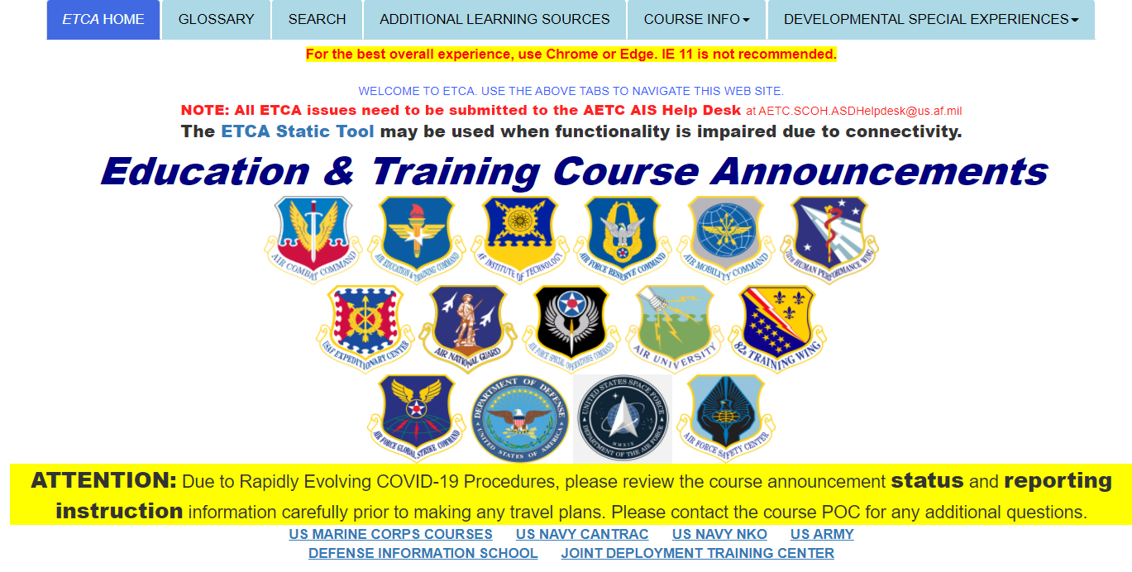
A3B FD Mission - ETCA
Notes:
Another catalog that the team worked hard to return to you is the Education and Training Course Announcements catalog.
Formerly used by Unit Training Managers predominantly, the ETCA provides additional knowledge concerning training and education opportunities. The original ETCA server was taken offline several years ago due to security issues and was resurrected on Sharepoint through a cooperative effort between the A3B team and the AETC/CSS. Their efforts during the COVID pandemic allowed course status updates to communicate travel instructions and other imperative information.
I want to take this opportunity to shout out to Mr. Jesus “Chewy” Caro and Ms. Rita Pedroza of the AETC Sharepoint team for their responsiveness in updating the ETCA for your benefit.
Most recently, the ETCA was changed to include our United States Space Force Guardians. If you explore the catalog now, you’ll see all the offerings from across the DAF and also links to opportunities from sister service providers. If you have questions concerning the ETCA catalog, Ms. Shelly Petruska and her team receive ETCA mail at AETC.A3PZ.ETCAInbox@us.af.mil SLIDE

Slide 5
A3B FD Mission - Badges
Notes:
Our teammates in A3BA, Accreditation and Certification Branch, were charged with developing a Digital Credentialing System that provides clarity to both Airmen and Supervisors, capturing the skills our Airmen currently possess and identifying the gaps in terms of development for mission readiness.
We intend to accomplish this through the creation of what we call the “21st Century Airmen Resume” or “Digital Portfolio”, a technology-enabled solution using existing off-the-shelf technology to accelerate growth.
Our Team developed a 6-step process to create these Digital Credentials (Badges) consisting of the following: Identify, define, map, build, execute and test.
But what is a Digital Credential you might ask?
It is a visible, portable record of verified knowledge, skills, abilities and observable behaviors.
The metadata embedded within the digital credential is what sets it apart from our more traditional ways of capturing learning such as transcripts. This “portfolio” actually contains the work product artifacts. For example a paper on current research of the Science of Learning or a module the earner developed for assessing learning using a gaming approach.
These Verified Credentials are Personal, Transferable, Translatable and Shareable both internally and externally but more important are searchable to allow Commanders to quickly identify Airmen with unique combinations of skills that might be needed for a particular mission requirement.
There are many more exciting things I could tell you about the badging efforts but there’s only so much time. If you have questions about what is being done today with digital credentials, the A3BA team awaits your communication at AETC.A3BA.Workflow@us.af.mil
Now I would like to focus on what the recently retired Kathryn Burk, her more-than-capable successor, Dana Horn, and their team are doing for you, the Learning Professionals of the DAF! SLIDE

Slide 6
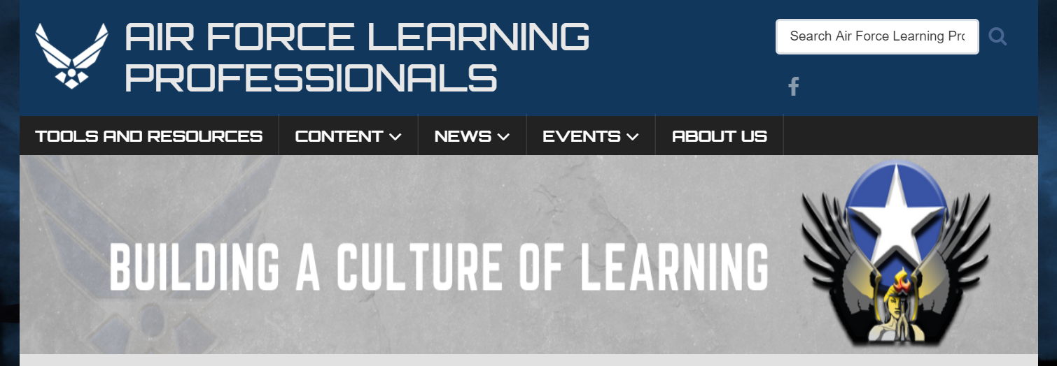
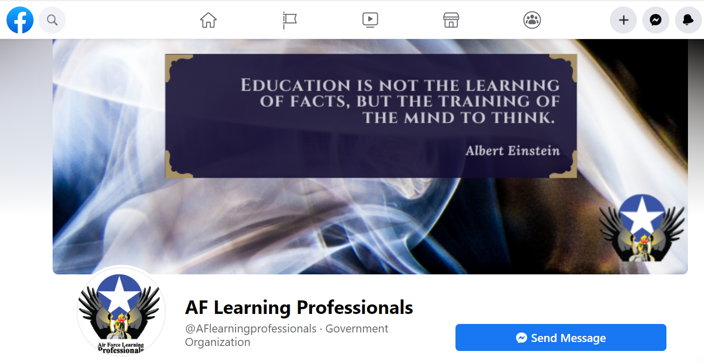
A3B FD Mission
Learning Professionals Specific
Engagement / Resources
Website - https://www.learningprofessionals.af.mil/
Facebook Public Page / Private member-only Group
Career Support
Competency Models Creation
CFETP Creation – 1750 and 1712
Notes:
For those of you who haven’t heard the term, a Learning Professional is anyone, civilian or military, who is involved in the design, development, and delivery of learning opportunities. But the term also includes all those members who support, resource, and provide administration to education and training services.
In 2017, Dr. Matthew Stafford, the AETC lead for Learning Transformation, challenged me as the DAF functional for the community, to grow the capabilities for collaboration between Learning Professionals. We identified several different initiatives to provide opportunities for LPs to engage in continually developing their own competency to design, develop, and deliver engaging learning experiences for Airmen. We desired to create those opportunities for collaboration, sharing of content, development of competencies, and networking among the LPs.
With his support, we initiated the “Learning Professional’s Consortium” in 2019 and hosted nearly 300 LPs at a live event. The Consortium was recognized by leadership as an outstanding gathering where innovative ideas and uses of existing tools were shared.
In order to provide 24/7 access to the latest in innovative application of learning theories, methodologies, and technologies, the A3BP team created the Learning Professionals Website. This outstanding product is a public-facing site that can be accessed from any computer or device. The content is curated by our talented team to ensure quality and legal requirements are met. I invite you to access the webpage and explore the content. Particularly the “News” tab where your fellow Airmen LPs are recognized for the outstanding work they do. Perhaps you might want to submit a colleague or an organization for the Spotlight!
In our discussions with LPs, they expressed a desire to collaborate using devices. Not everyone has unfettered use of a .mil computer throughout the day. The team’s answer to that is two Facebook pages…one public-facing and a private DAF group. It is easy for you to post articles or conferences that you want to recommend to your fellow LPs and participate in discussions concerning learning-related content.
In 2018, leadership expressed a desire that we provide continuous development opportunities for all LPs based on verified competencies. So, our teammates in A3J completed competency models for both content design and development professionals and content delivery specialists. These models were validated using surveys of LPs throughout AETC. Recently, the Learning Professionals Gap Analysis that Dr. Randy Coats will share in detail this afternoon highlighted the Learning Professional community’s belief that they needed additional development in the areas of student-centered instruction, development of content for synchronous and asynchronous online delivery, and the use of emerging technology for creating engaging learning modules.
We are currently in the final stages of completing the first-ever Career Field Education and Training Plan for designers and developers utilizing teams of design and development experts from across the DAF. We hope to have these valuable tools to you in the Fall. As soon as the hands-on work is complete and the product is in the publication pipeline, we will attack the content delivery model using the same process.
If you have any questions about the products we covered, Dana and her team await your communication at AETC.A3BP.LP@us.af.mil SLIDE

Slide 7
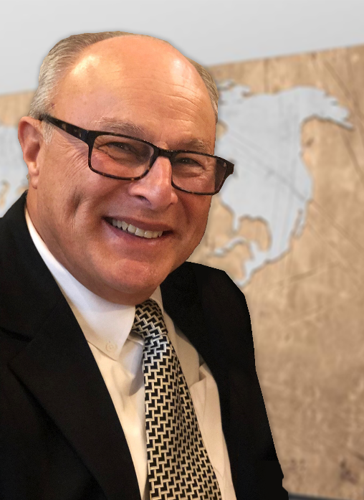
Logo Recognition
Official Learning Professional’s Logo
Created in 2019 through a contest among all DAF military and civilian Learning Professionals
Depicts an angel warrior delivering light and enlightenment to DAF learners
Winning submission: Mr. Steve Lamas, 325 TRSS, Tyndall AFB
Notes:
One of the elements that historically unifies communities is an icon or logo. So we publicized a competition within the LP community to design a logo that represents what we do. There were many entries and the competition was fierce but the winning entry emerged clearly. Mr. Steve Lamas from the 325 TRSS at Tyndall submitted the logo you see. The logo depicts an angel warrior delivering light and enlightenment to Airmen through learning. It has since been formally adopted and you are welcome to use it if you wish.
We planned to bring Steve to San Antonio for the 2020 Consortium and have Dr. Stafford present him a stainless steel travel mug with the logo emblazoned on it. As we are all aware, COVID-19 deleted the opportunity to meet in person last year. So, we wanted to recognize Steve as publicly as possible for his outstanding work. Steve, if you are listening, the whole Learning Professional community of which you are a valued member applauds you.
Now, it’s time to turn our attention to our featured speaker for the day…Dr. Bonnie Houser. SLIDE

Slide 8
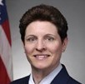
Featured Speaker
Dr. Bonnie Houser
Deputy Chief, Air Force Voluntary Education
Advisor on programs ranging from MilTA through AFCOOL and USMAP
Retired CMSgt spent 27 of 28 years of military service focused on training, education, and development for Airmen
Entered the USAF in 1984 through the Air National Guard teaching Combat Arms and then NCOA
Leads by example having earned a MS of Education and a Doctorate in Post-Secondary and Adult Education
Notes:
Currently, Dr. Houser is the Deputy Chief for Air Force Voluntary Education. The depth and breadth of Dr. Houser’s knowledge in the area of DAF training, education, and development programs is unmeasurable. If it has to do with an Airman learning something…she’s done it.
Dr. Houser spent most of her military career in various AF schoolhouses. She started in the Air National Guard but soon transitioned to AD, teaching CATM for 16 years. She went on to teach the NCO Academy content and then served as the senior enlisted Training and Education representative at the Pentagon.
She felt so strongly about the value of education to Airmen that she achieved a doctorate in Post-Secondary and Adult Education. She is truly a shining example of what an airman can do if she puts her mind to it.
Without further ado, I would like to introduce you to my friend and colleague, Dr. Bonnie Houser.

