Slide 1
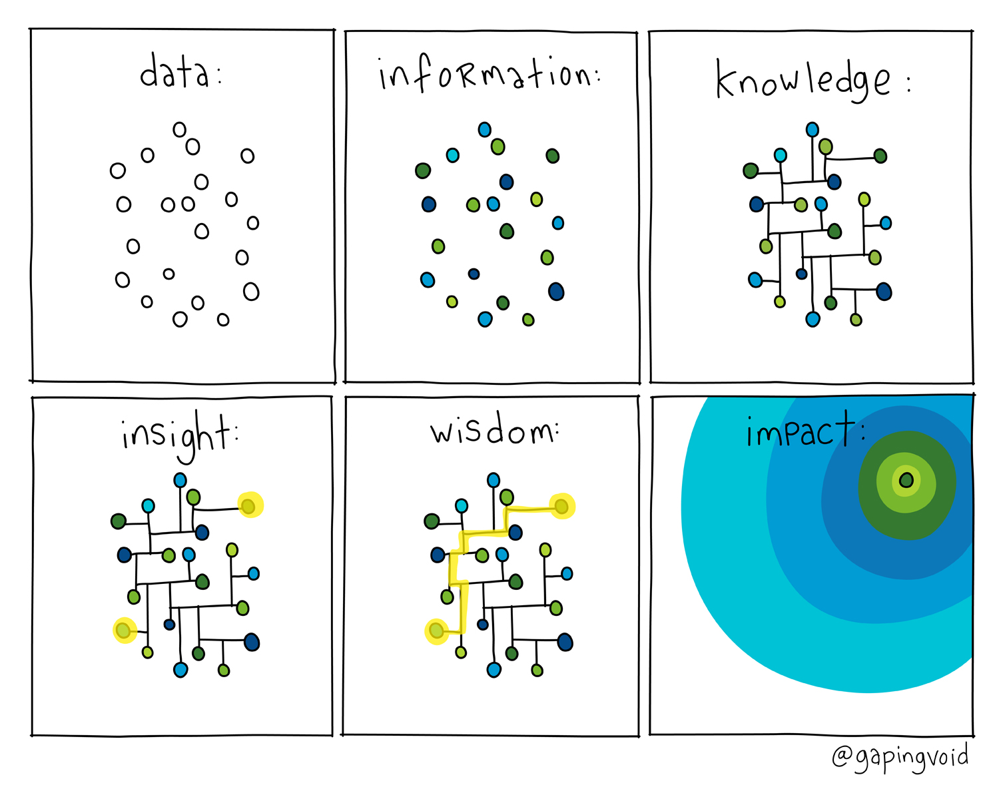
Learning…to be our best selves
Dr. Brian E. A . “Beam” Maue, AFWERX Co-founder, First Mission Leader, 2017-2020

Slide 2
From an “Idea” to “#16 in the World”…in under 3 years
29 July 2020
- Best Workplace for Innovators
- Rated #16 / 865 reviewed world organizations
- Scored by Fast Company & Accenture

Slide 3
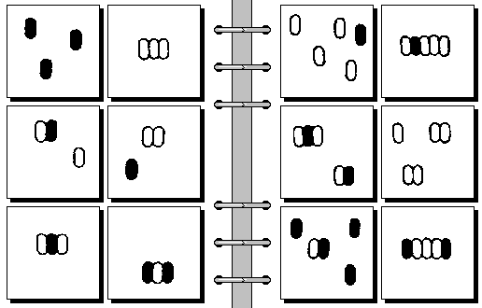
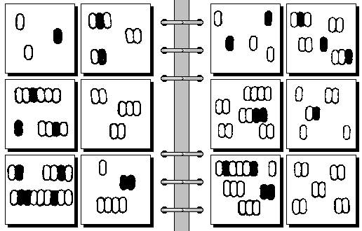
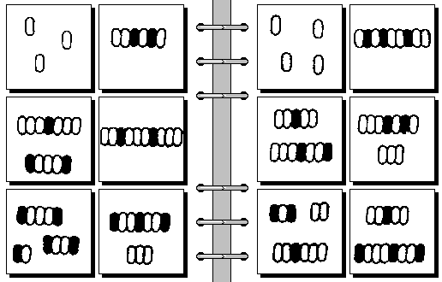
Bongaard problems #88 – 90…Learning Curves & “What is the Pattern?”

Slide 4
Bongaard problems #88 – 90…Learning Curves & “What is the Pattern?”

Slide 5
What does it mean to be “Intelligent?”
“The ability to accurately predict”
…and how was that predictive ability built?
…and how was that predictive ability built?

Slide 6
We practice, train, exercise, experiment, and learn with “models”…
Let us look at one…glance at another…

Slide 7
Factors
Linking
One’s
Will
In the beginning, it was dark…

Slide 8
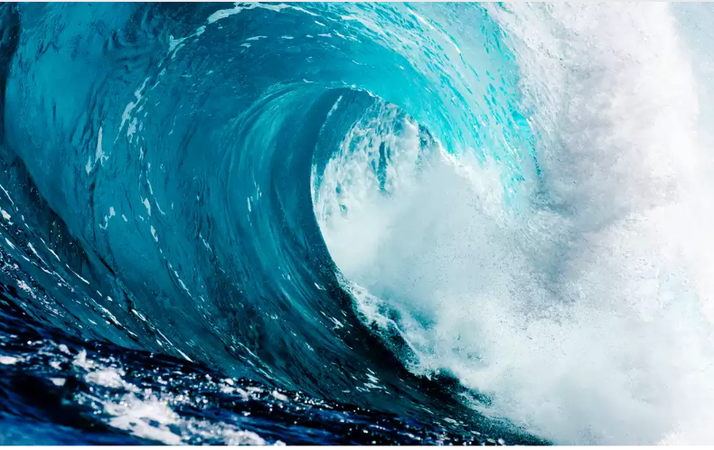
Factors
Linking
One’s
Will
Environment:
Threats & Opportunities
F.L.O.W.

Slide 9
Factors
Linking
One’s
Will
Environment:
Threats & Opportunities
F.L.O.W.
“Self
Actualization” ???
Esteem
Belonging ~ “Love”
SAFETY
PHYSIOLOGICAL

Slide 10
Factors
Linking
One’s
Will
Environment:
Threats & Opportunities
Mission & Strategy
F.L.O.W.
Tell your Story !

Slide 11
Factors
Linking
One’s
Will
Environment:
Threats & Opportunities
Mission & Strategy
F.L.O.W.
Culture
Tell your Story !

Slide 12
Factors
Linking
One’s
Will
Environment:
Threats & Opportunities
Mission & Strategy
F.L.O.W.
Culture
Tell your Story !
Structure:
Formal & Informal

Slide 13
Factors
Linking
One’s
Will
Environment:
Threats & Opportunities
Mission & Strategy
F.L.O.W.
Culture
Tell your Story !
Structure:
Formal & Informal

Slide 14
Factors
Linking
One’s
Will
Environment:
Threats & Opportunities
Mission & Strategy
F.L.O.W.
Culture
Structure:
Formal & Informal
Inputs +
Processes
Alignment
Strength
Flow
Outputs
User
Feedback

Slide 15
Factors
Linking
One’s
Will
Environment:
Threats & Opportunities
Mission & Strategy
F.L.O.W.
Culture
Structure:
Formal & Informal
Inputs +
Processes
Outputs
User
Feedback
Why wait?
Tell your Story on Day 1 !

Slide 16
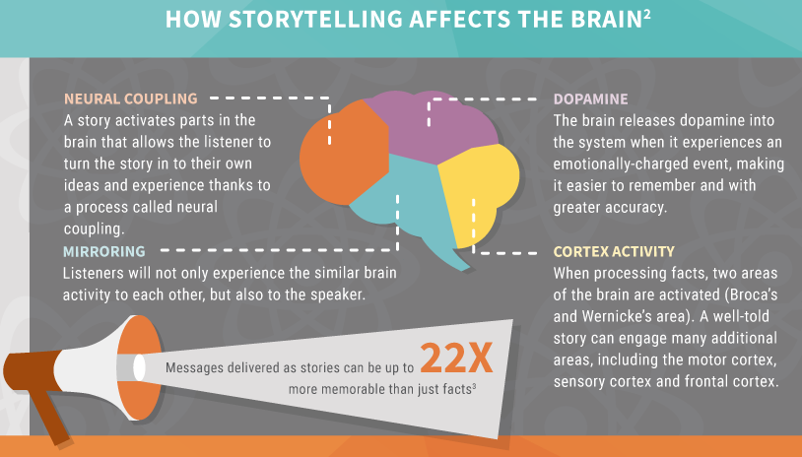
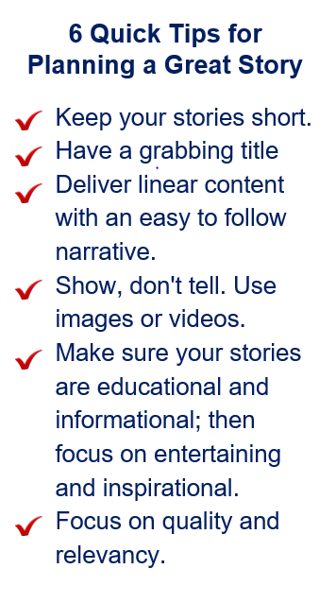
Storytelling holds a key to reaching your audience…
https://www.iliyanastareva.com/blog/how-to-tell-a-great-story

Slide 17
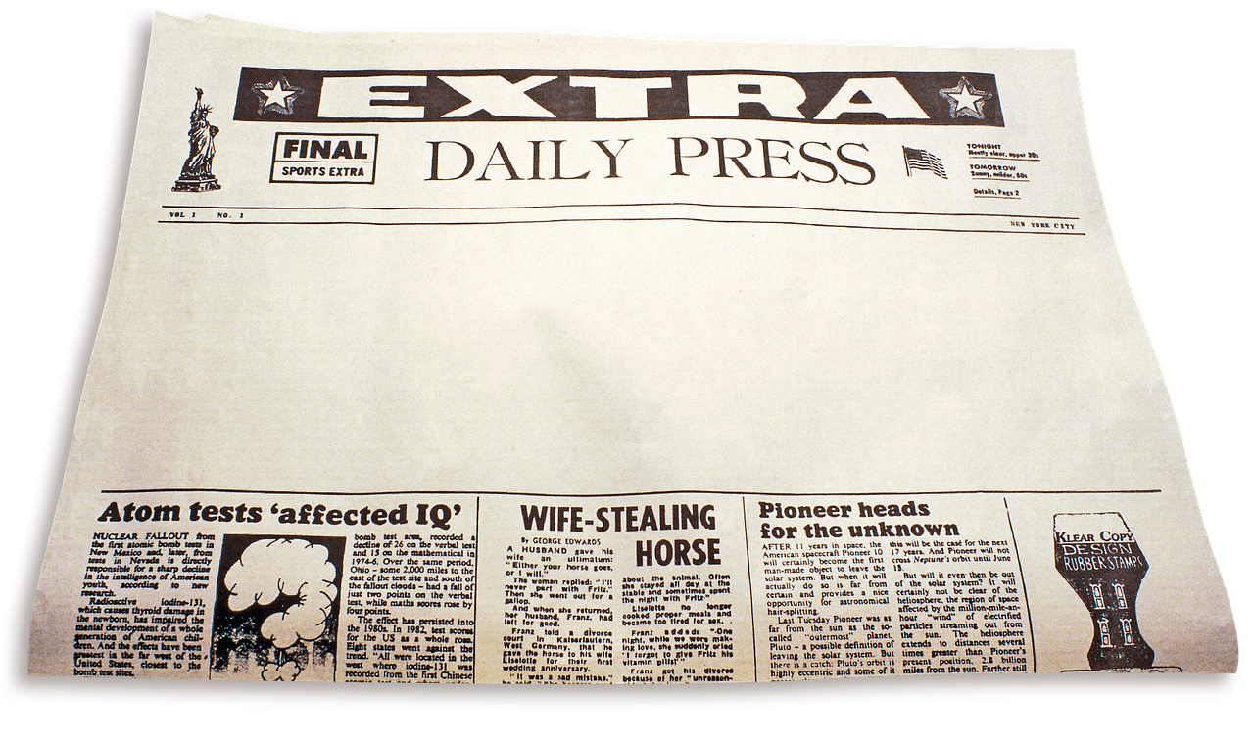
Scenario #1: . Work or non-work environment, in-person event, from media exposure, etc.
Think back to a learning experience when a communication to you
was exceptional, productive & effective at motivating you to use your energy and take action.
Describe that experience with:
a) A Newspaper / Website style headline that is 7 words or less
b) Two behaviors/actions/characteristics/feelings exhibited during the experience, by you or the messenger
a. Headline (7 words or less) :
b. Positively framed behaviors & actions (5 words or less):
I.
ii.

Slide 18
“Chance favors only the prepared mind.” ~ Louis Pasteur
H₀: All talent and all environments produce equal results
H_{a}: Diverse talent who
are empowered to play to their strengths,
own a common vision,
and may learn from non-success,
…can produce a world class capability.
Proposed: The AFWERX startup years demonstrated that an
learning organization (experiment!) can self-actualize.
(VCSAF Wilson, SECAF Barrett)
https://www.afwerx.af.mil/resources/AFWERX-Book.pdf

Slide 19
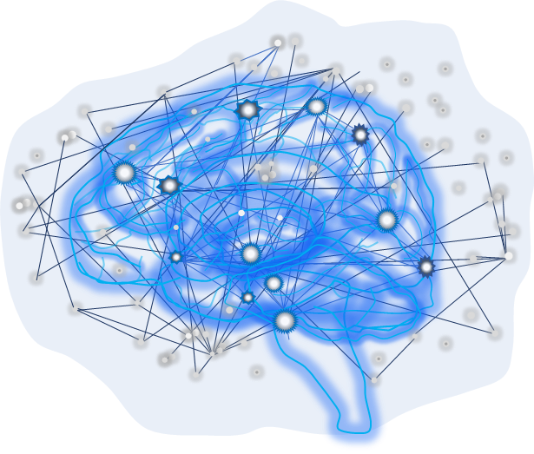
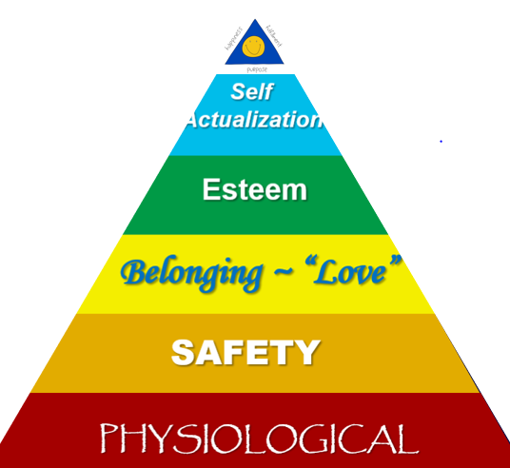
Share stories and learn…to be our best selves:
I. You help others connect dots
II. Others can help you create “Best Environments”
II. You help others become more intelligent
“The ability to …. ??? …“
IV. Intelligence allows us to reach Self-actualization

Slide 20
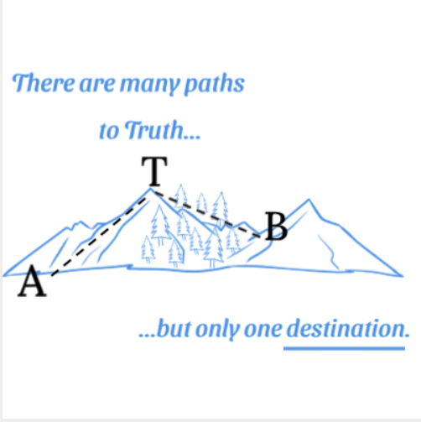
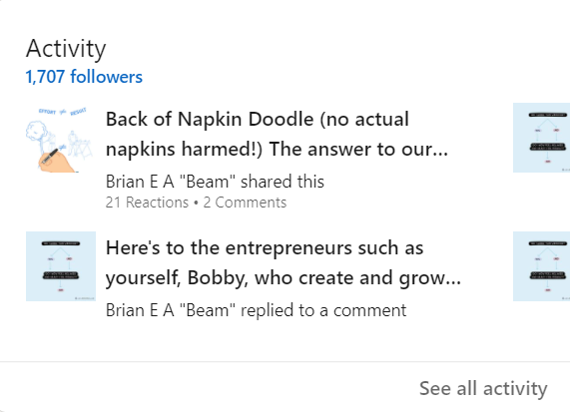
Learning…to be our best selves...and with others:
https://www.linkedin.com/in/beamaue/

