Slide 1
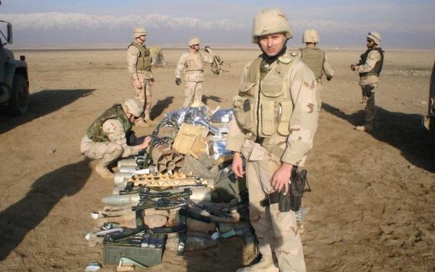
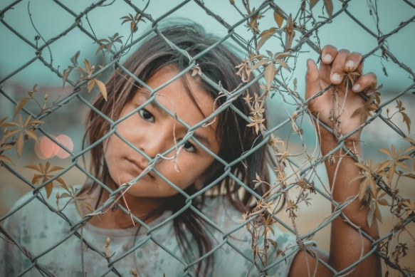
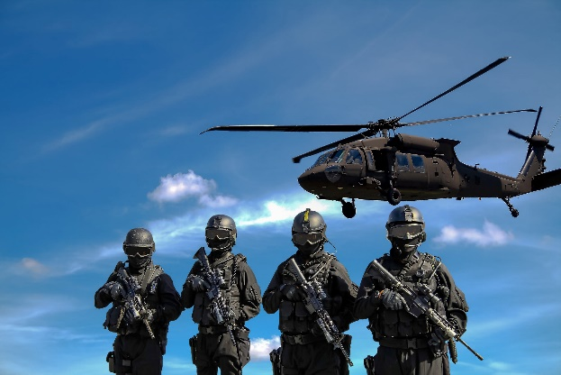
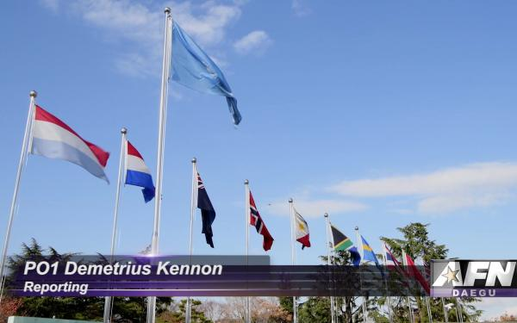
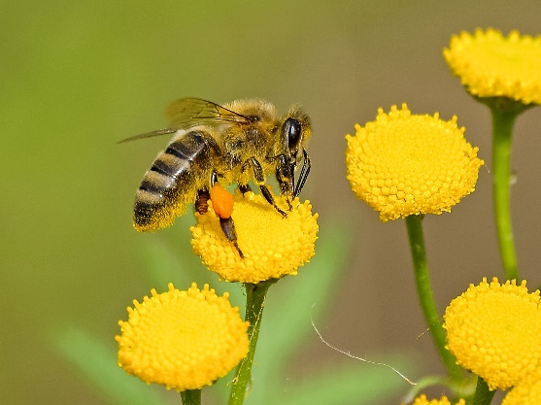
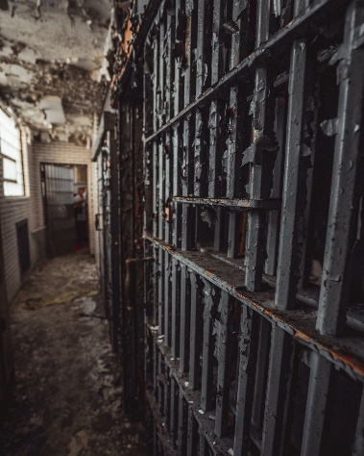
Sociocultural Systems Thinking Practical Exercises
Santos, A.¹, Mateo, J.C.², McCloskey, M.J.², Babin, L.B.¹, & Polander, E.N.²
¹U.S. Army Research Institute for the Behavioral and Social Sciences & ²361 Interactive LLC
OVERVIEW
Military leaders need sociocultural systems thinking skills (SCST) to understand complex operational environments.
SCST is an individual’s capacity to continuously build and analyze a mental model of sociocultural relationships and dynamics that exist in an environment, and leverage this model when planning, preparing, executing, and assessing situations.
This research is part of the U.S. Army Research Institute’s (ARI’s) broader efforts to understand and develop SCST in the military.
RESULTS
PRACTICAL EXERCISE 1:
SITUATION ANALYSES OF REAL EVENTS
What is it?
Facilitated small-group exercises designed to scaffold thinking about SCS.
Real events highlight SCST elements.
Incorporates discussions, critical thinking about complex events, and peer critiques.
How does it work?
Watch video
Identify relevant stakeholders and their connections to each other
Consider how issue change over time
Describe second- and third-order effects
Determine interrelated problems
Formulate intervention to address issues
PRACTICAL EXERCISE 2:
SCENARIO TRAINING FOR SYSTEMS THINKING
What is it?
Facilitated exercises that can be done anywhere with small groups to scaffold thinking.
Incorporates descriptions of real world problems, tips to elicit group reflection, and information about specific SCST elements targeted by the exercise
How does it work?
Listen to case description
Answer various case-specific questions, e.g.:
Describe unintended consequences
Determine what information is needed to propose sustainable interventions
Identify how stakeholders’ goals conflict
Consider potential effects of more recent events on identified courses of action
Target SCST Elements
1. | Understand limitations of linear thinking
2. | Comprehend complex operational issues
3. | Understand stakeholder groups
4. | Understand SCS structural characteristics
5. | Visually represent SCS interdependencies
6. | Examine multiple perspectives and historical background
7. | Envision sustainable interventions
8. | Adapt courses of action
Adult Learning Principles
1. | Problem-centered
2. | Offer opportunities to interact with peers
3. | Offer opportunities for repetition and deliberate practice
4. | Involve feedback to and from peers and facilitators
5. | Provide opportunities for individual and group reflection
6. | Sufficiently rich and complex to make repetition worthwhile
7. | Useable by a wide range of echelons
RESEARCH OBJECTIVES
Identify SCST elements in a military context that are amenable to training.
Identify methods to train leaders for understanding sociocultural systems (SCS).
Develop proof-of-concept training materials to evaluate acceleration of SCST skills.
Event Descriptions
Spending in Afghanistan
Event Descriptions
China’s One-Child Policy
Body Market
METHOD
Reviewed literature on SCST and adult learning, as well as existing course material relevant to systems thinking.
Interviewed Army leaders on operational incidents, training methods, and SCS.
Sample: 18 Officers (CPT to COL), various MOSs, average of 3 deployments for an average of 30 months.
Critical decision method: Verbal recall of cross-cultural incident.
Analysis of literature, interviews, and existing course materials focused on identifying target SCST elements and recommended tasks for practical exercises.
Pilot exercises were developed for testing.
Exercises helped officers understand SCST elements, especially SCS interdependencies and stakeholder groups.
Officers found the exercises engaging, challenging, relevant to Army operations, and helpful for visualizing problems.
CONCLUSION
Adult learning principles can be applied to development of SCST.
In particular, interacting with peers was critical to developing SCST.
Officers appreciate the complexity of systems and believe that practice is required to become well-versed in SCST.
Officers’ input was critical to the development of practical exercises.
Romani Children Sold
Afghans Farming Poppies
Cash for Kim
Disrupt Military Operations
Peacekeepers Turned Perpetrators
Prisons and Crime Rates
Collapse of Honeybee Colonies
Synthetic Drugs
Flint, MI Water Crisis
War on Drugs
Naples Garbage Crisis
Open source images courtesy of Pexels.com
Disclaimer: The research described herein was sponsored by the U.S. Army Research Institute for the Behavioral and Social Sciences, Department of the Army (Contract No. W911NF-15-C-0031). The views expressed in this presentation are those of the author and do not reflect the official policy or position of the Department of the Army, DOD, or the U.S. Government.
POC: Ava Santos, Ph.D., 851 McClellan Ave, Ft Leavenworth, KS 66027, ava.j.santos3.civ@mail.mil, (913)684-9778
Market for School Girls

