Slide 1







Data Management & Protection in a Multi-Cloud World
Enabling Secure, Easier, & More Affordable Solutions

Slide 2




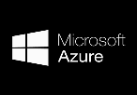






















Data Protection for Multi-Use Case, Multi-Cloud
Long Term Retention
Disaster Recovery
In-Cloud Protection
Backup to Cloud
Secondary DC / SP
Primary
Scalable Platforms
SD or Appliances
Intelligent Deduplication Reduced Network Traffic & Faster Backups
Cloud Ready
Wide Cloud Vendor Support
Widest Protected Workload Ecosystem
VM VM VM
VM VM VM
Home grown & custom apps

Slide 3


















Data Domain Virtual Edition 4.0 for Public Cloud
B E N E F I T S
Easily deployable through the public cloud marketplaces
Leverage industry leading deduplication for cloud storage efficiency
Lowest Cost to Protect
C l o u d P r o v i d e r
Amazon
S3
Azure
Software Defined
Deduplicated Data Object Storage Encryption at Rest
Google
Hot Blob Cloud Storage
Encryption In-Flight
Efficient Replication
C l o u d M a r k e t p l a c e
GovCloud (US)
Government

Slide 4








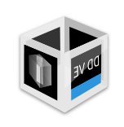
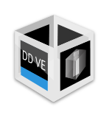













Replicate to Cloud
Leverage Cloud for Data Protection Appliance Replica
B E N E F I T S
Replicate Data Protection Appliances to Major Cloud Providers
Easily deployable through the Public Cloud Marketplaces
Efficiently Replicate to, from, & between cloud providers for extreme data mobility
Write deduplicated data to object storage
Leverage Industry Leading Deduplication for Lowest Cost-to-Protect
Deduplication efficiency leads to
lowest cost of egress
Deduplicated Data
B E T W E E N
R E G I O N S
Deduplicated Data
B E T W E E N R E G I O N S
Deduplicated Data
S3
Blob
B E T W E E N C L O U D S
B E T W E E N C L O U D S
FROM THE C L O U D
T O T H E C L O U D
D e d u p l i c a t e d C o m p r e s s e d
E n c r y p t e d
On - P r e m i s e
GovCloud (US) Government

Slide 5














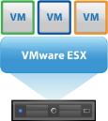
Recover to the Cloud
B E N E F I T S
Leverage public cloud services for Disaster Recovery of VM’s
3 Clicks to Failover
2 Clicks to Failback
Recover in minutes
Seamless integration with on- premises Data Protection
Swagger API for Storage &
Policies
Application consistent recovery to AWS
Recover directly to VMware Cloud on AWS
Low Cost-to-Operate
Massive Transformational Benefit – ROI / TCO
Leverage Cloud for Application Availability & Business Continuity
C l o u d P r o v i d e r
Amazon S3
AMI
Amazon
EC2
GovCloud (US)
Encryption at Rest
O b j e c t S t o r a g e
ESX
Azure Blob
Azure
VMs
VHD
Encryption In-Flight
Compress Delta Change
On - P r e m i s e
SWAGGER
Data Domain / Avamar
IDPA
Backup
Dell Customer Communication - Confidential

Slide 6




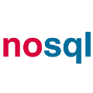
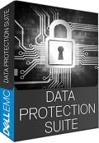



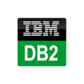




In-Cloud Data Protection
Accelerating Data Protection for Business Applications
B E N E F I T S
The performance, efficiency, and reliability of Data Domain in the cloud
Scales up to 96TB
Leverage Industry leading deduplication for Lower TCO
50% Faster Backups
Enterprise data protection software to ready-to-deploy appliance
Modern HTML5 UI
Same functionality in cloud as on
premise
Manage on-premise and in cloud workloads from one location
Available in AWS & Azure Marketplaces
GovCloud (US)
C l o u d
P r o v i d e r
Government
Azure
C l o u d
A p p s
P r o t e c t i o n S t o r a g e
Encryption In-Flight Efficient Replication
Deduplicated Data Object Storage Encryption at Rest
Amazon Azure
S3 Hot Blob
DD VE
GCS
Nearline
Client Direct
E n t e r p r i s e D a t a P r o t e c t i o n f o r C l o u d W o r k l o a d s

Slide 7

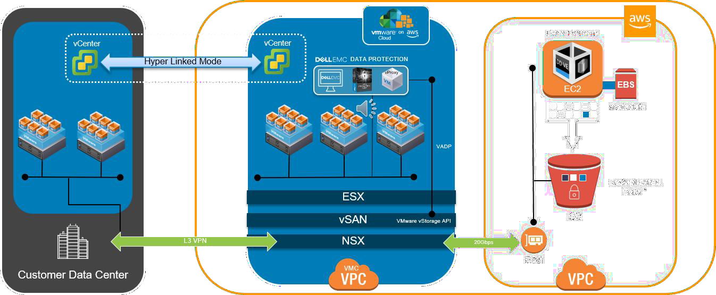

Data Protection for VMware Cloud
B E N E F I T S
Single SKU Data Protection Bundle SW and Protection Storage
Per Host based Subscription
Easy add on to VMC licensing model
Leverage investment and expertise in VMware to accelerate the Cloud journey
Leverage Industry Leading Deduplication for Cloud Efficiency
Multi-User Case Protection for In-Cloud Protection and Cloud DR
Enable Hybrid Cloud Data Protection
FedRAMP Certification Pending
Cloud Marketplace

